Slide 1
Review of Galactic objects in the TeV sky
Takayuki Saito
Kyoto University, Hakubi center

Slide 2
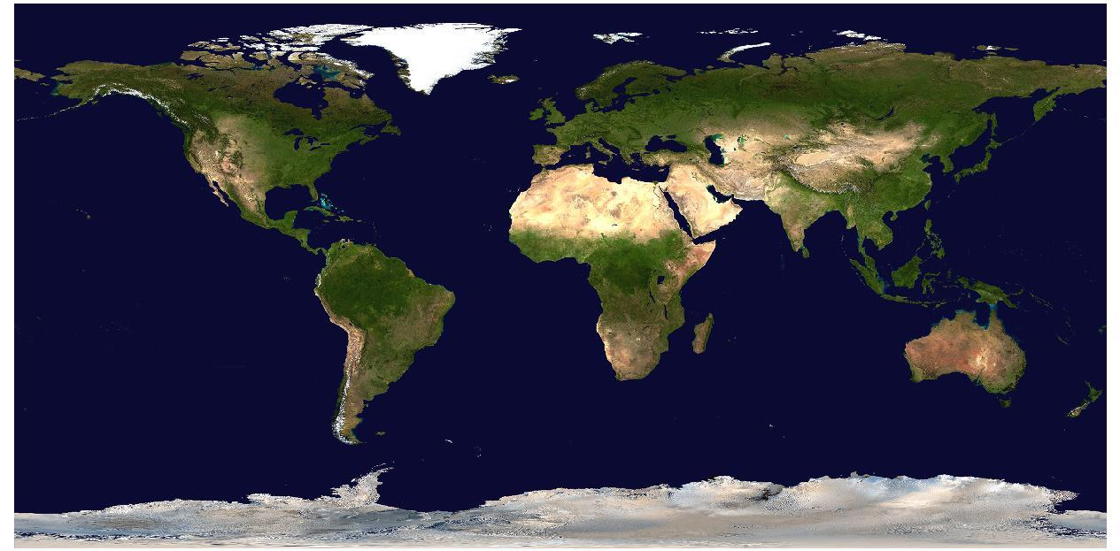
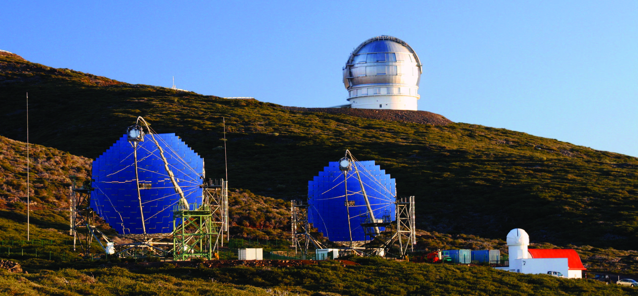
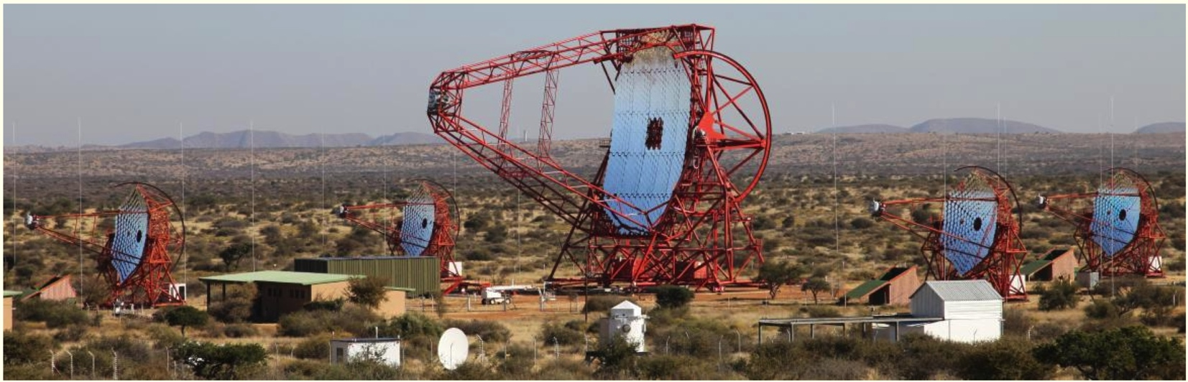
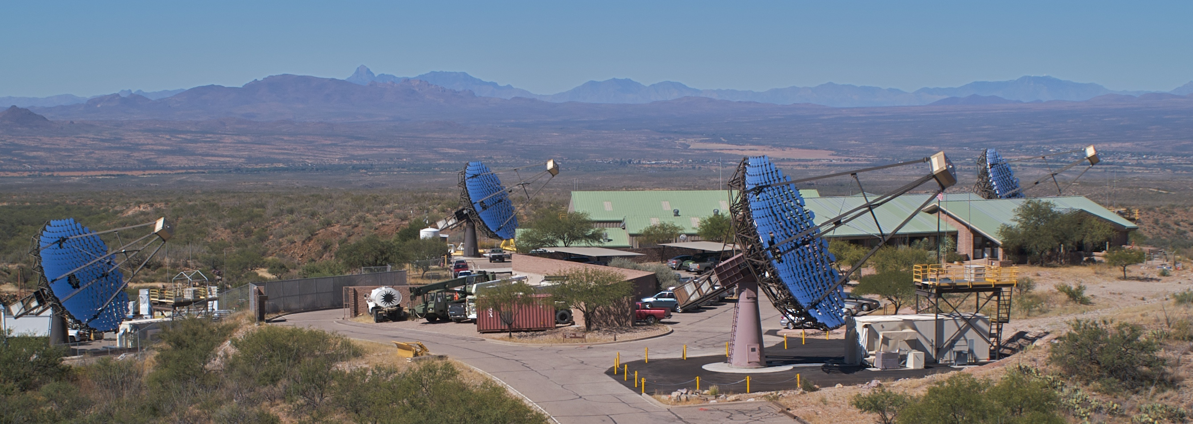
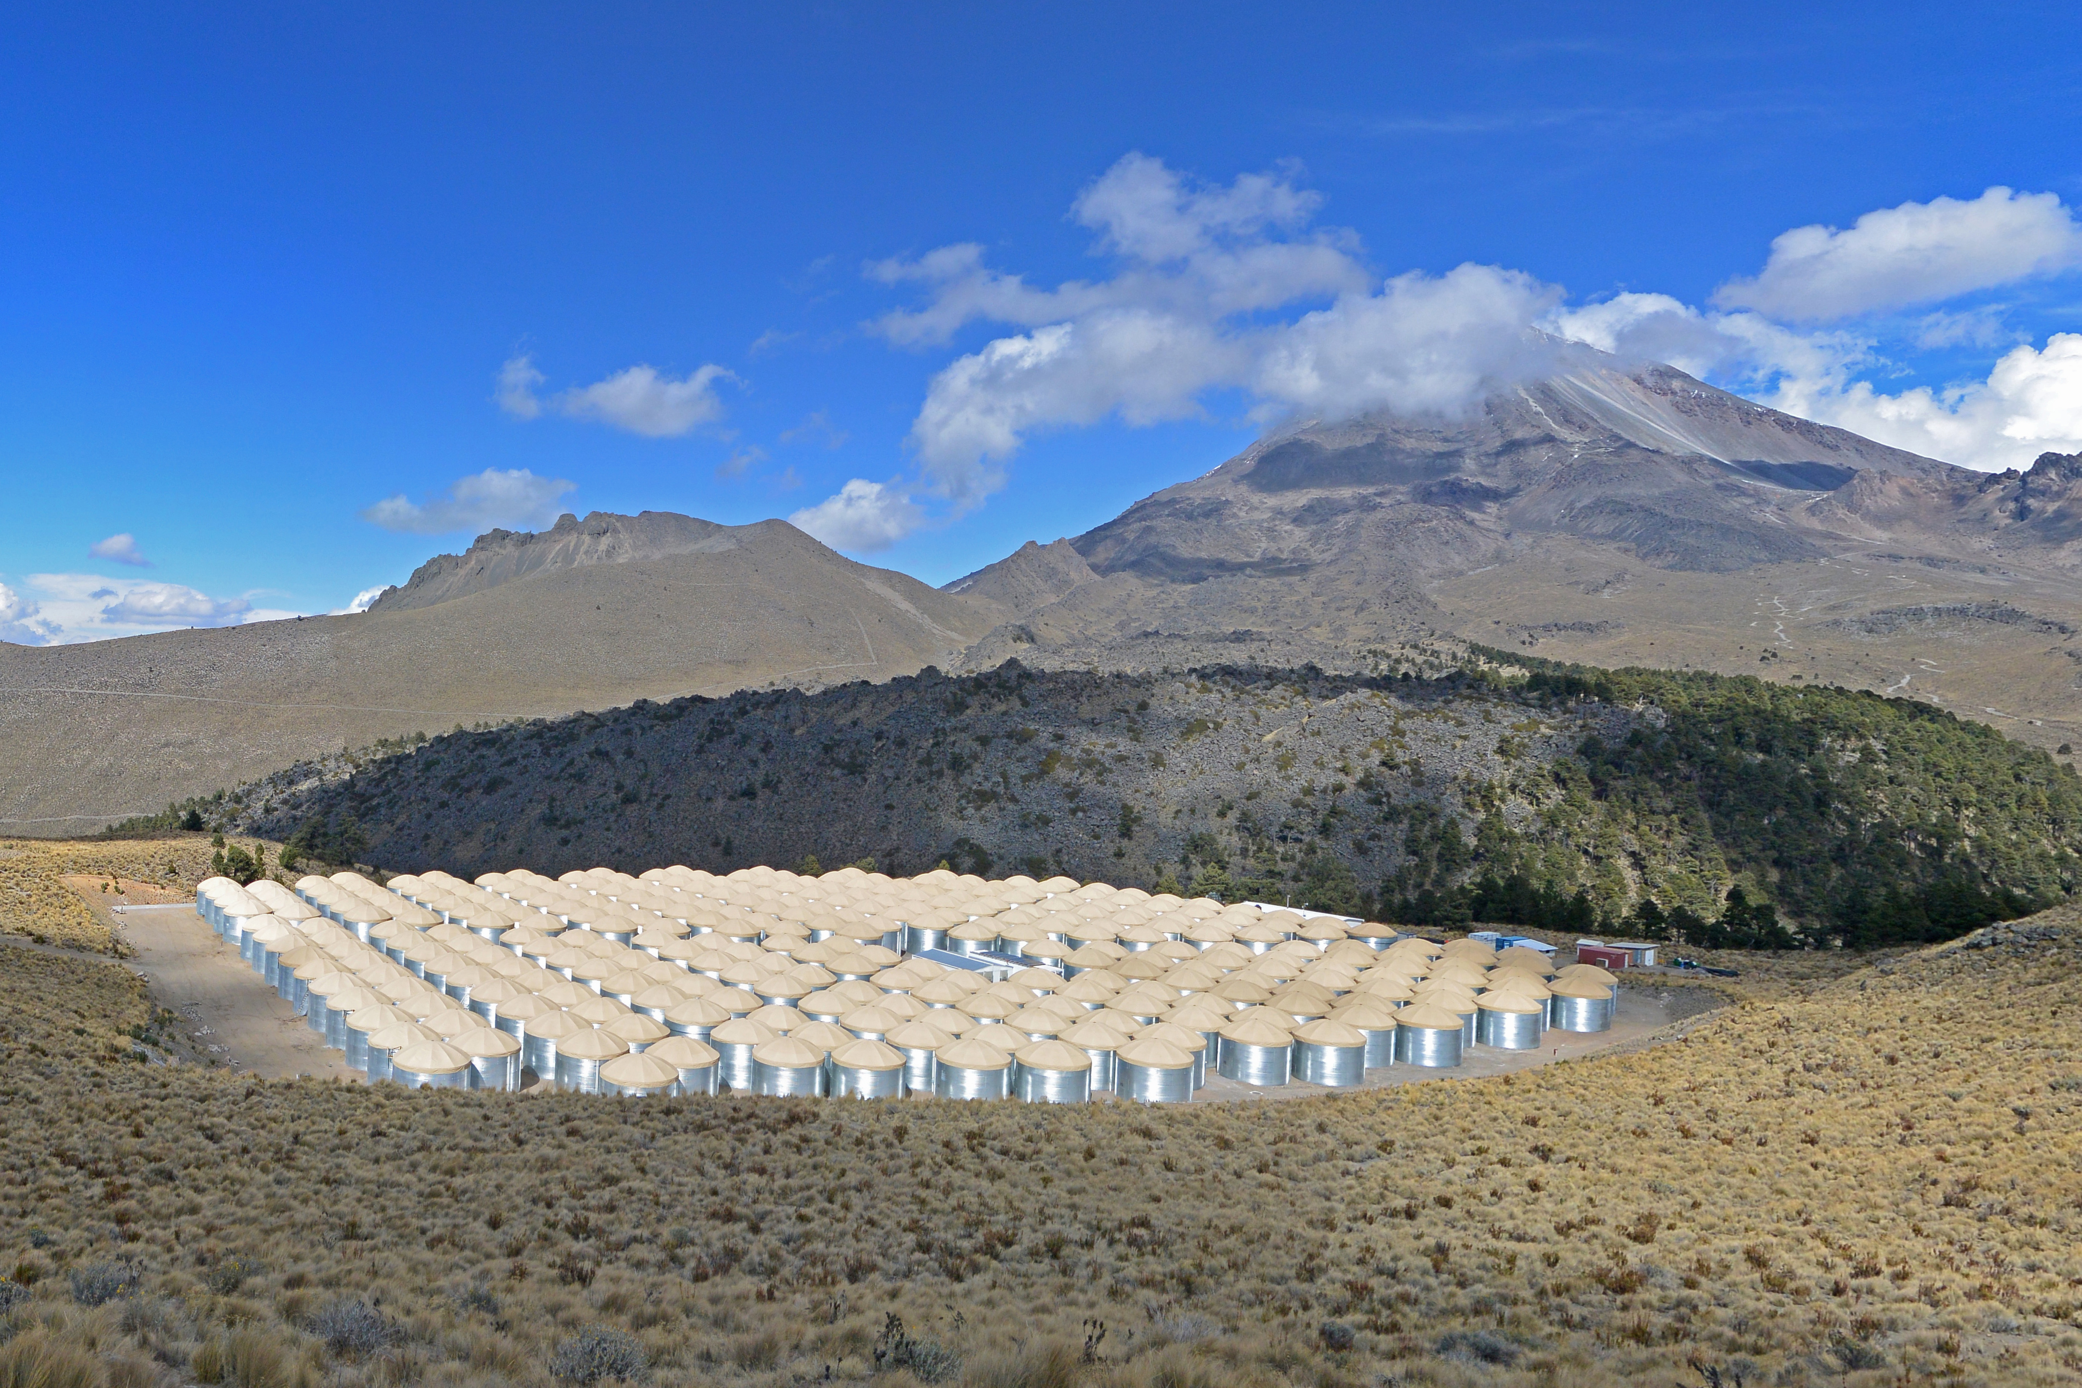
Current TeV Instruments
MAGIC, IACT 17m x 2
HESS, IACT 28m x 1 + 12m x 4
VERITAS, IACT 12 m x 4
HAWC, Air Shower Array 22000 m²
IACTs:
Point Source Sensitivity: ~0.5 %Crab for 50h
Energy Threshold: ~100 GeV
Angular resolution: ~0.05 degree
FOV: ~3 deg radius
Duty cycle: 10%
HAWC:
Point Source Sensitivity: ~25 %Crab for 1 year
Energy Threshold: ~10 TeV (median)
Angular resolution: 0.8 degree
FOV: ~60 deg
Duty Cycle: 90%

Slide 3
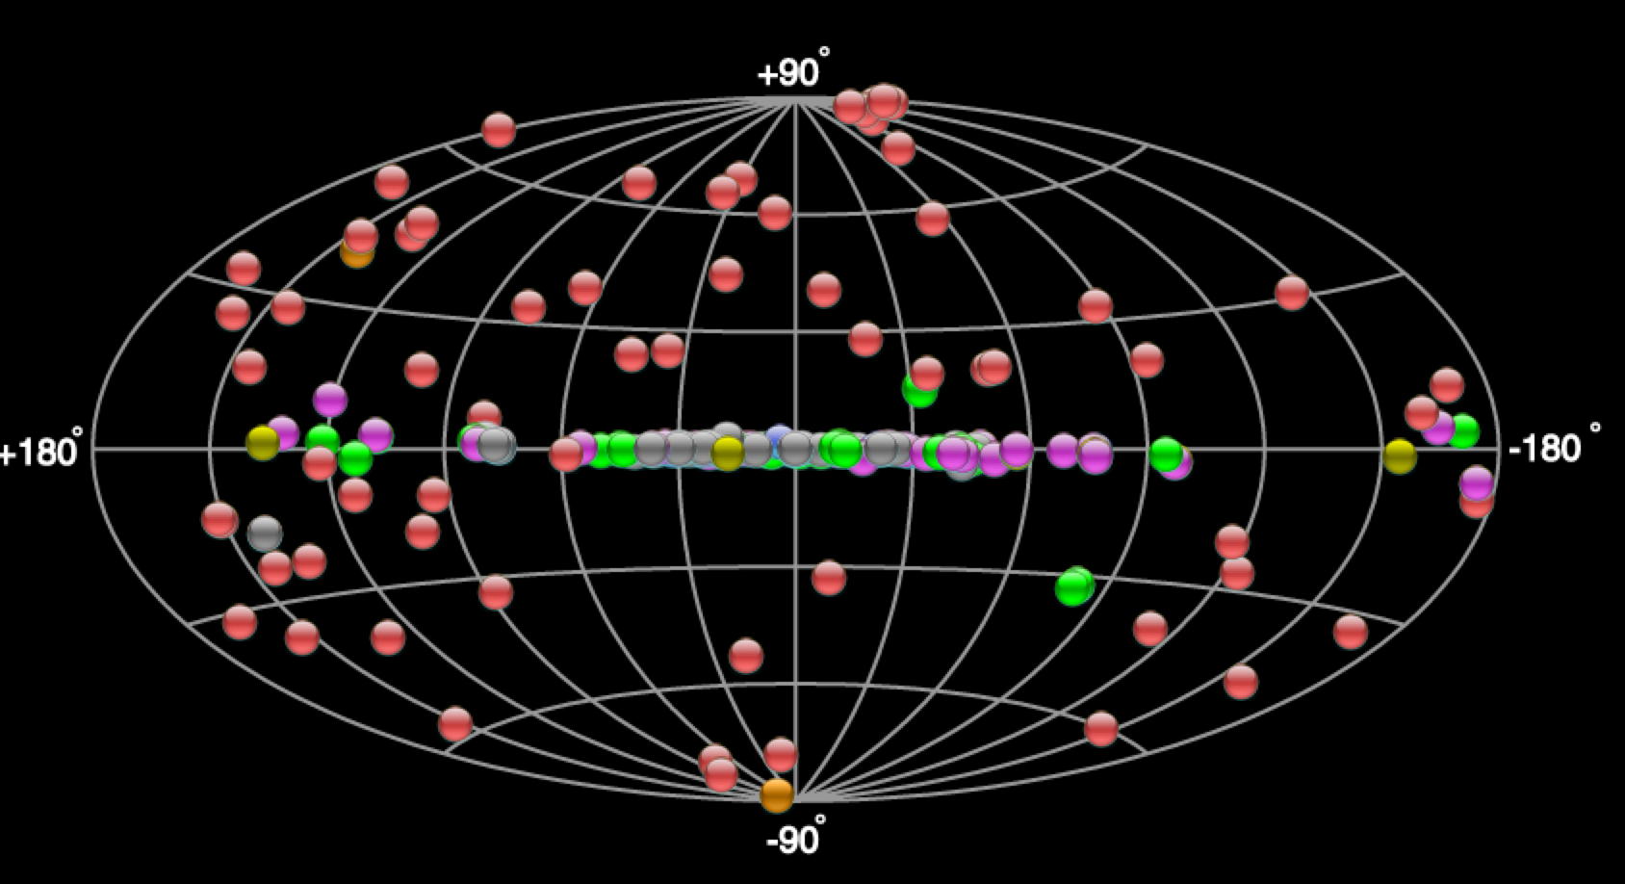
TeV sky
TeVCat: http://tevcat.uchicago.edu/
Galactic | 69
- SNR | 23
- PWN | 33
- PSR | 2
- Binary | 6
- Clusters | 5
Extragal. | 72
- LMC | 3
- Blazer | 63
- FRI | 4
- Starburst gal. | 2
UNID | 35
Total | 176
40% Extragal. 40% Galactic + 20% UNID

Slide 4
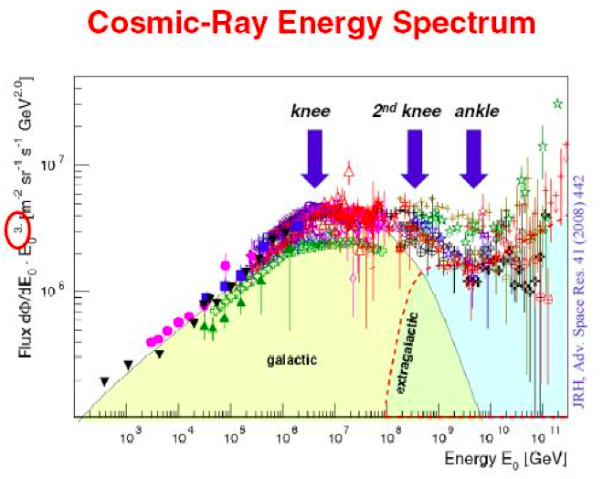
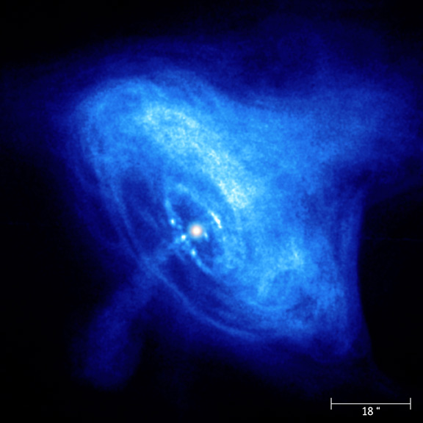
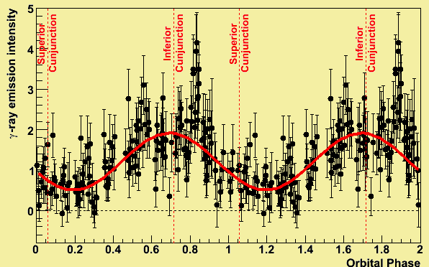
Galactic Science with TeV γ-rays
Search for Origins of Cosmic Rays up to knee energies
  They should exhibit
  VHE emission
  from hadronic interaction
  extending up to 100 TeV
many!
several
one!?
2. Physics of different types of extreme objects
  SNR – detailed study of shock acceleration
  Pulsar – neutron star magnetosphere
  PWN – pulsar wind termination
  Binary – cyclic study of different conditions
  Cluster – collective effect of objects
  Galactic Center – supermassive black hole

Slide 5
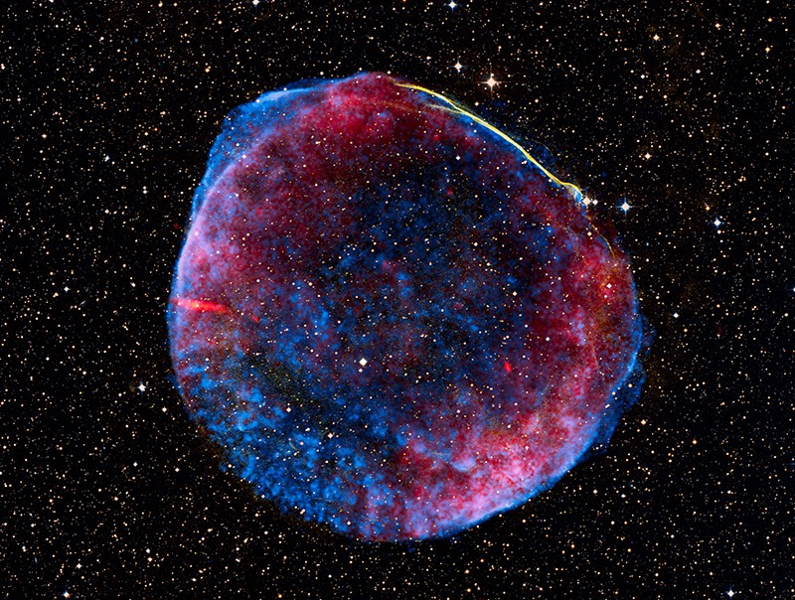
Supernova Remnants (24 detected)
  Supernova Remnants: ~400 in the Galaxy (SNRcat).
    Shock wave accelerates proton and e- up to PeV.
    Thought to be origins of galactic CR.
    4 types,
      Shell-type(~250),
      Filled (mainly PWN, ~50),
      Plerionic Composite (PWN+Shell, ~50)
      Mixed Morphology (Thermal X-ray at center + Radio Shell, ~40)
Type | # of VHE srcs | Tev Source
Shell-type | 15 | Tycho, Cas A, SN1006, Vela Jr. etc
Filled | - | Counted as PWN
Mixed Morphology | 8 | IC443, W28 (4 sources around), W49B, W51?, CTB37A
Plerionic Composite | 1 | G015

Slide 6
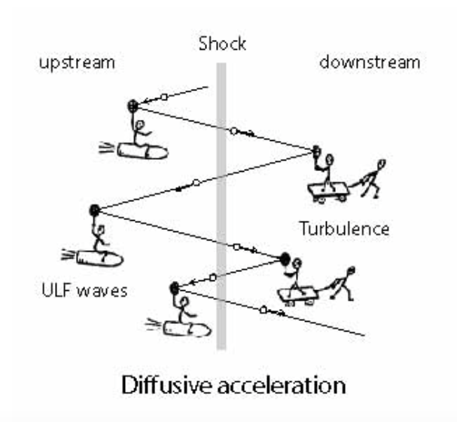
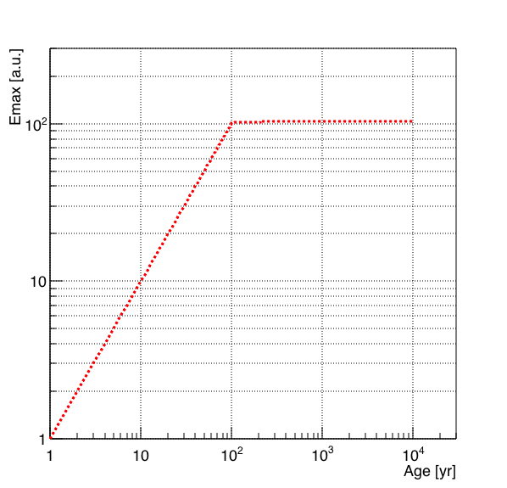
Diffusive Shock Acceleration
Shock velocity
Larmor radius
Super-simplified
Emax
Free expansion phase
Sedov Taylor phase
Free
expansion
Sedov
Taylor
Acceleration efficiency is highest during Free expansion phase (< 100 yr)
Maximum attainable energy is already achieved at the transition time to Sedov Phase
During Sedov phase, efficiency decays rapidlyin time.
Possible Pevatron!

Slide 7
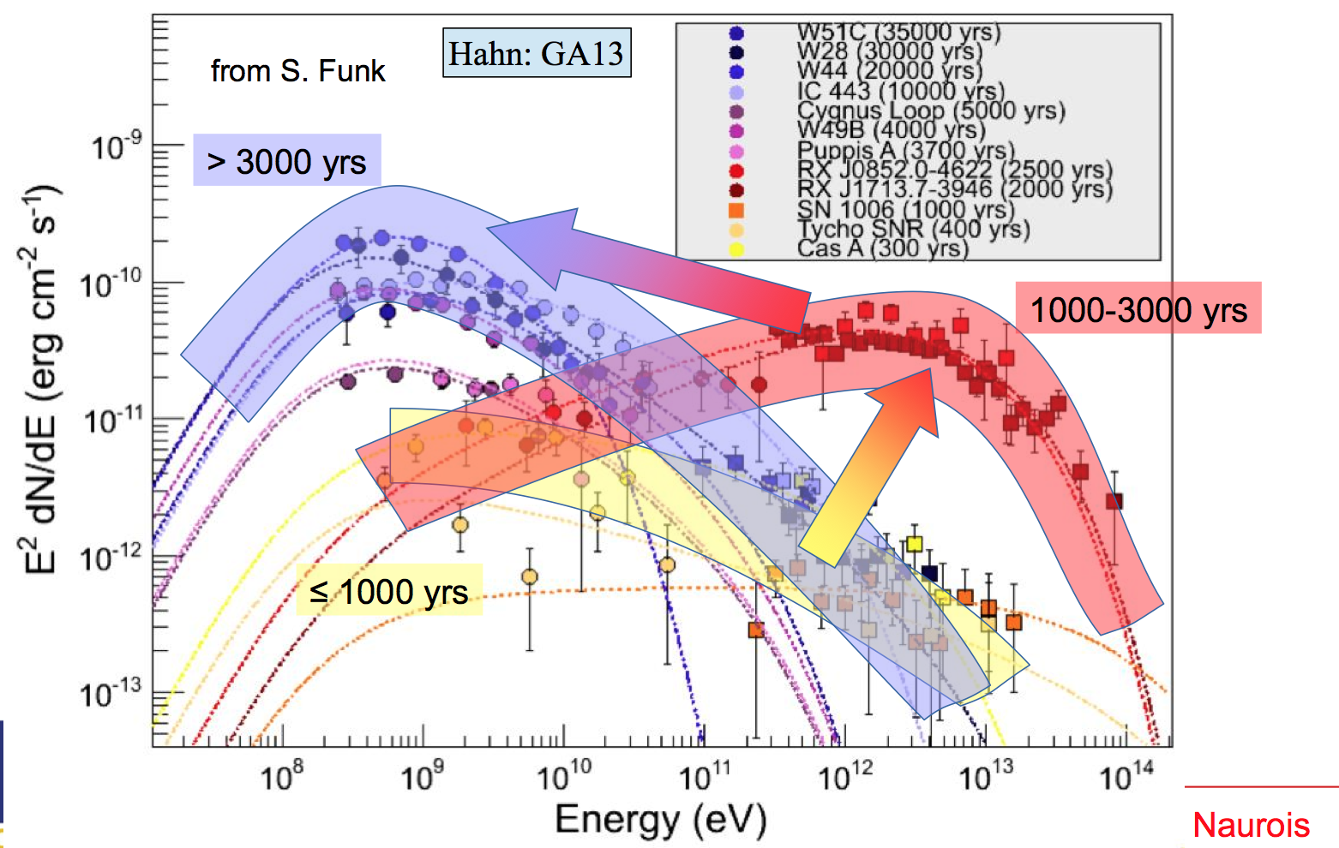
Spectrum vs Age
~Mixed Morphology
~Shell
Young (thus efficient accelerator) are bright in TeV.
However, no one continues up to 100 TeV … Maybe they all are too old??
Older ones are also detected. But morphology is different.

Slide 8
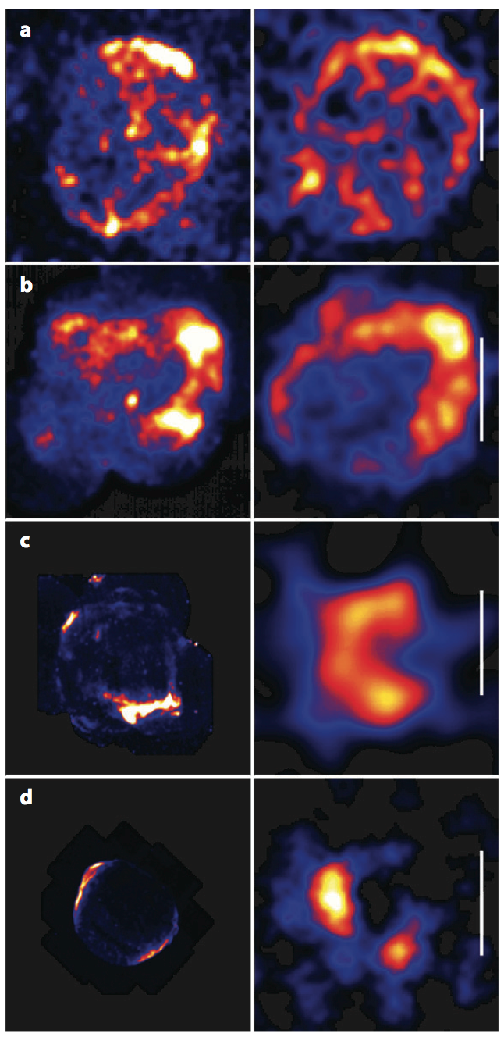
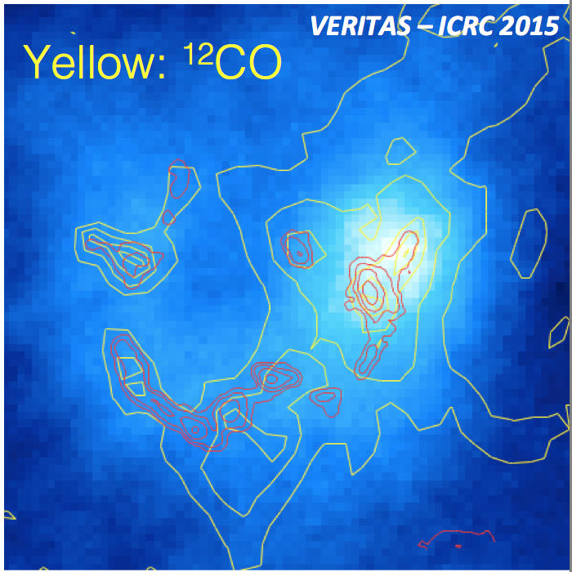
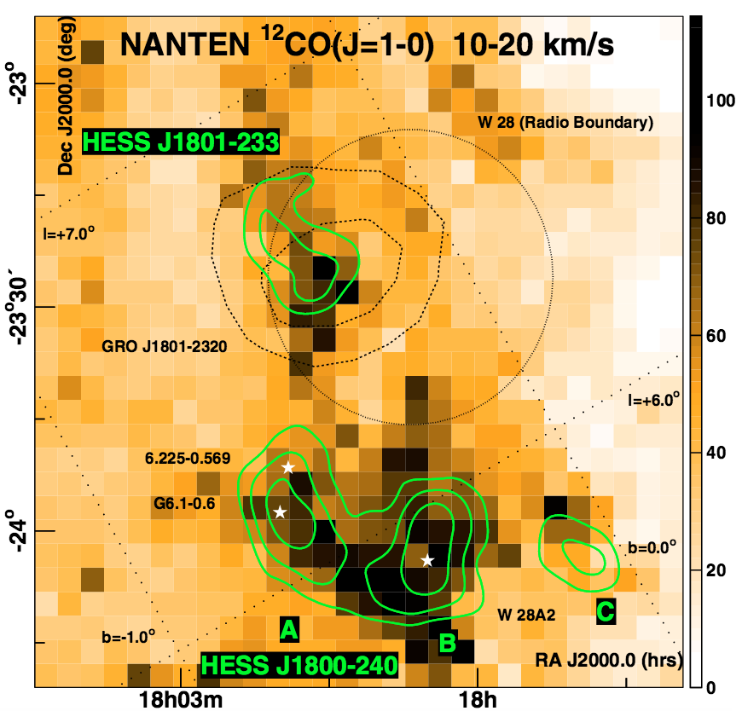
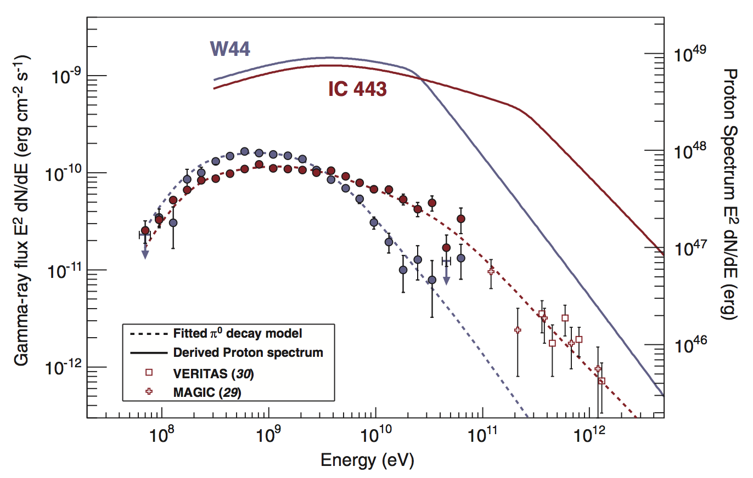
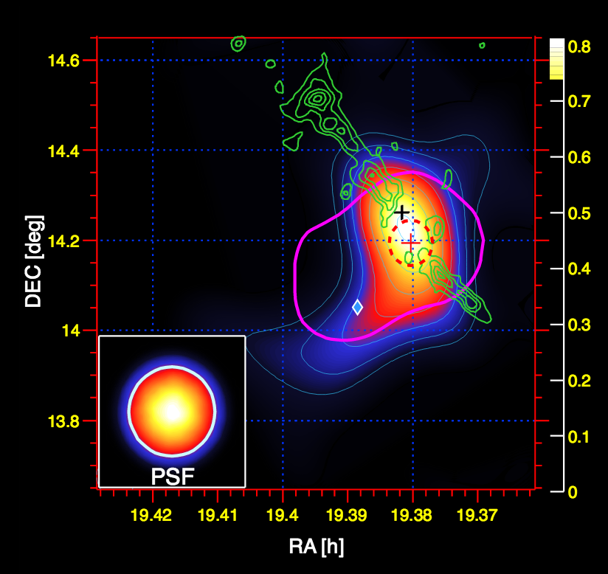
Morphology vs Age
Young
Old
X-rays
VHE
Red: HC0+
Vela Jr.
(2500 yrs)
IC443
(10000 yrs)
Shell-like VHE emission.
Well correlated with X-ray.
Effective acceleration on-going
RX J1713
(2000 yrs)
W28
(30000 yrs)
VHE Sources
Well correlated with gas.
Suggest Hadronic origin.
Some are confirmed by pion bump
RCW86
(2000 yrs)
SN1006
(1000 yrs)
W51C
(35000 yrs)
[Hinton & Hoffmann ARAA, 2009]

Slide 9
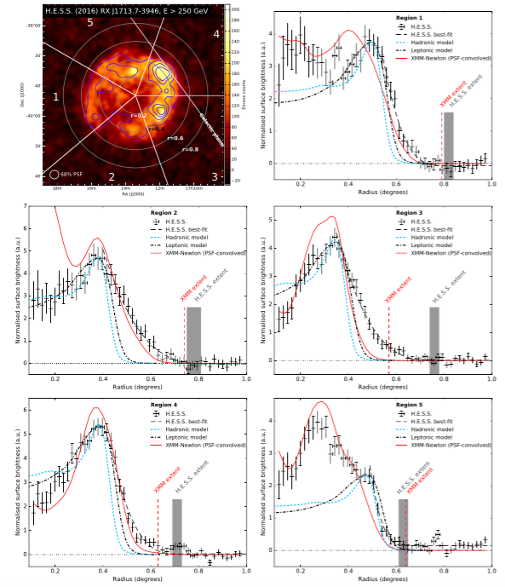
RX J1713.7-3946
H.E.S.S. Col. arXiv:1609.08671
Red line: X-ray profile
Data point: VHE profile
VHE emission is further extended than X-rays!
X-ray Synchrotron Shell:
high energy electron x amplified B
Indicates Shock front
VHE emission
either
Proton outside the shock
or
Electron IC outside the shock (B is weaker, but target photon is abundant)
>250 GeV, 164 hours
The larger VHE shell does not distinguish between hadronic or leptonic origin, VHE particles beyond the shock (precursor or escape) was first detected.

Slide 10
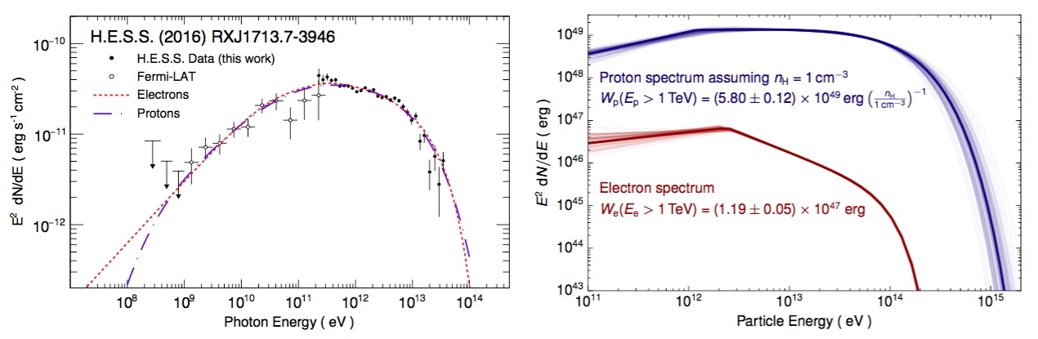
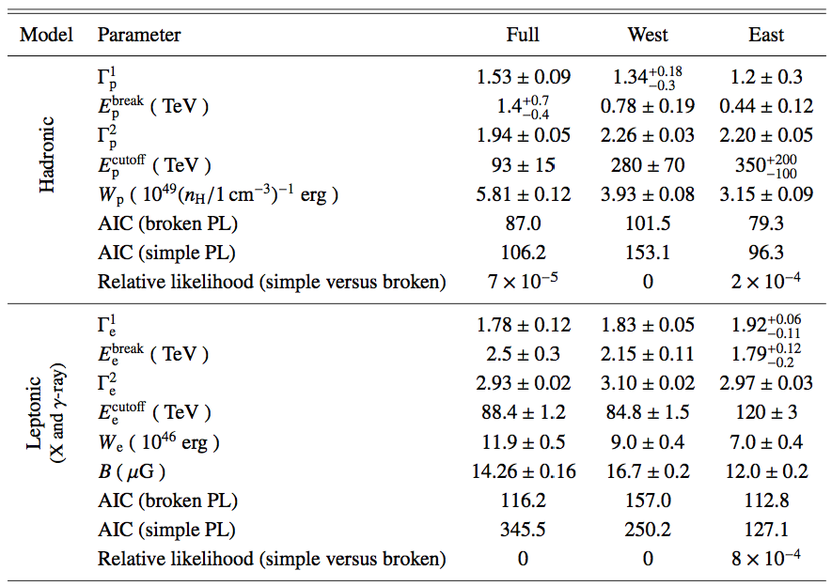

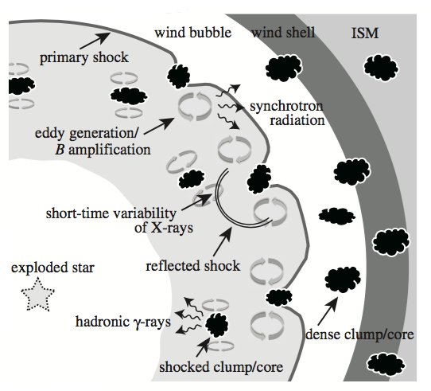
RX J1713.7-3946
H.E.S.S. Col. arXiv:1609.08671
Both p and e can explain the gamma-ray spectrum.
In both cases, spectrum should have a broken power-law with cutoff.
gamma
particle
Leptonic: break @ 2.5 TeV?
B is not strong enough….
Hadronic: break @ 1.4 TeV?
Clump model would explain the effect. Low energy particles cannot go deeply in the cloud (n=10³/cc)
T. Inoue ApJ 744, 2012

Slide 11
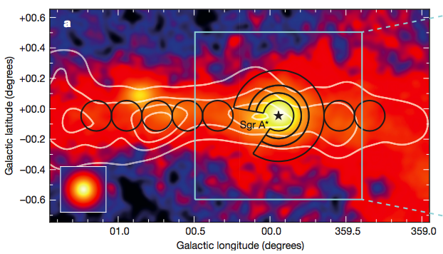
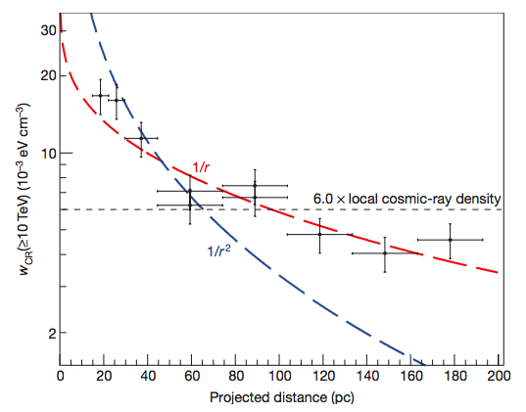
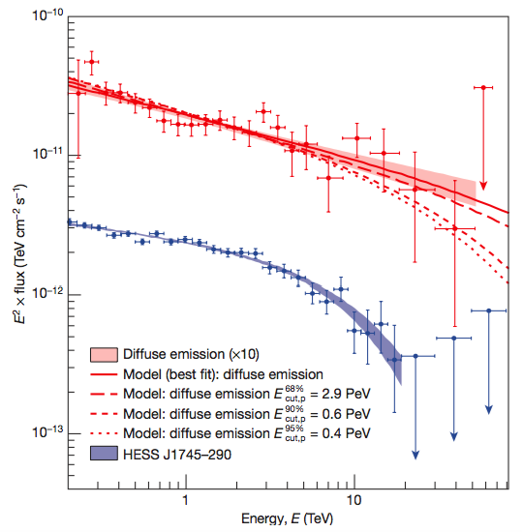
Galactic Center
H.E.S.S., Nature 531, 2016
CR density > 10 TeV
HESS
VHE emission
= Gas density x CR density
G0.9
Sgr A*
200 pc
CS line
CR density ~ 1/r up to 200 pc indicates
  Continuous injection from the center
  Longer than 2000 (D/10³⁰cm²s⁻¹) year
  Injection rate >10 TeV = 4e37 (D/10³⁰cm²s⁻¹) erg/s
  CR density ~ 1e49 erg
Injection particle spectrum should have
  Index should be -2.4
  No cutoff up to ~ PeV
What could be the source of particle injection?
  Single SN? -> continuous PeV injection > 2000 years unlikely
  >10 SN in 2000 years -> rate is too high
  Central BH? -> Possible (accretion flow?)
If accretion rate was much higher in the past (as shown in X-rays observation [Clavel et al., A&A 558 2013]), and provide 1e39 erg/s for 10⁶⁻10⁷ years, knee can be explained by this BH.
Diffuse component
Central Point source

Slide 12
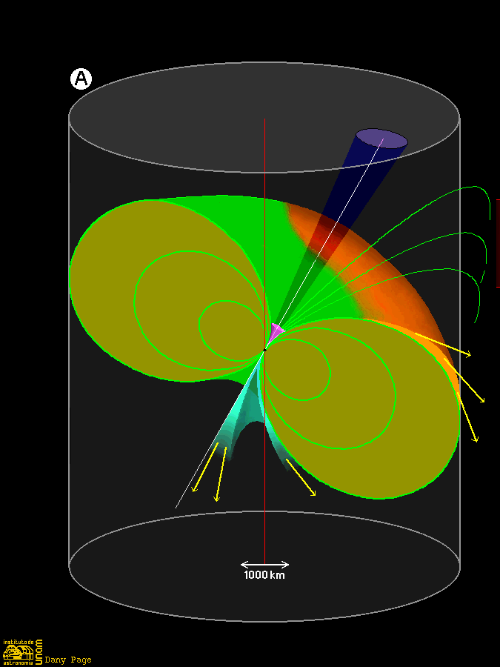
Pulsars (2 detected)
  Pulsars: ~ 2500 in the Galaxy.
    Rapidly rotating neutron star with strong B field.
Gamma-ray pulsars: > 160 in the Galaxy
  1/3 are milisecond pulsars
  Some are radio quiet
  Curvature radiation from outer magnetosphere
  Spectral break/cutoff at a few GeV
  Lowering the IACT threshold is the key
VHE Source | Age | Spindown Luminosity | B_{LC}
Crab | 1260 yrs | 4.5e38 erg/s | 2e6 Gauss
Vela | 11300 yrs | 6.9e36 erg/s | 9.5e4 Gauss

Slide 13
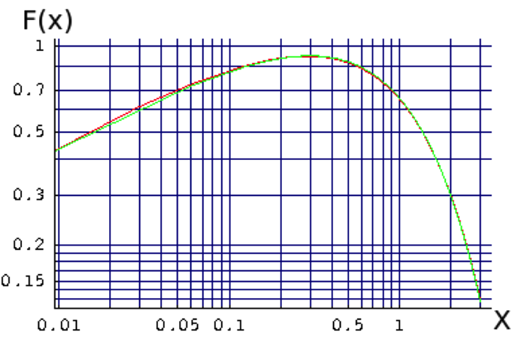

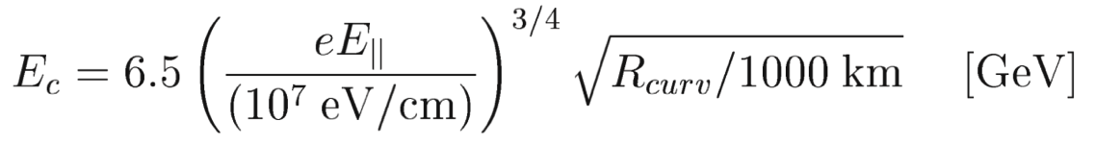
Why so bright in GeV and so dim in TeV
Synchrotron Radiation
Curvature Radiation
e
E field
e
Curved B field
(Perpendicular) B field
Strong Brake!
Exponential cutoff@GeV expected.
E|| 〜B_{LC}
R_{curv||} 〜R_{LC}

Slide 14
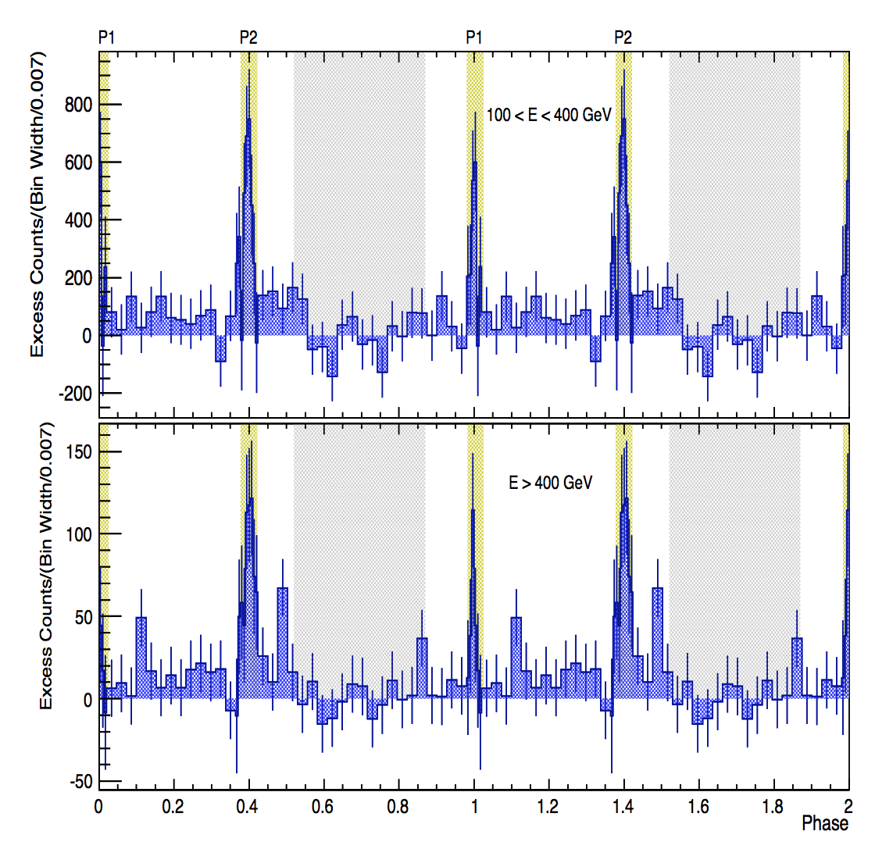
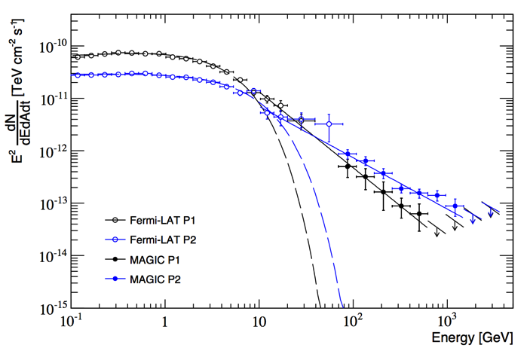
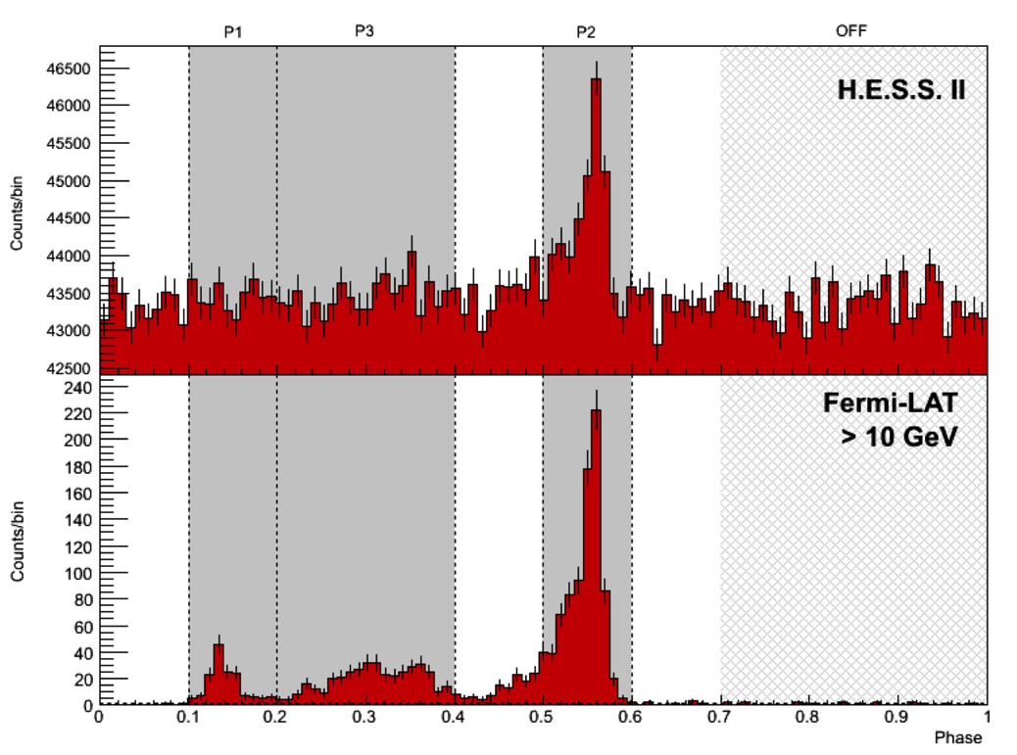
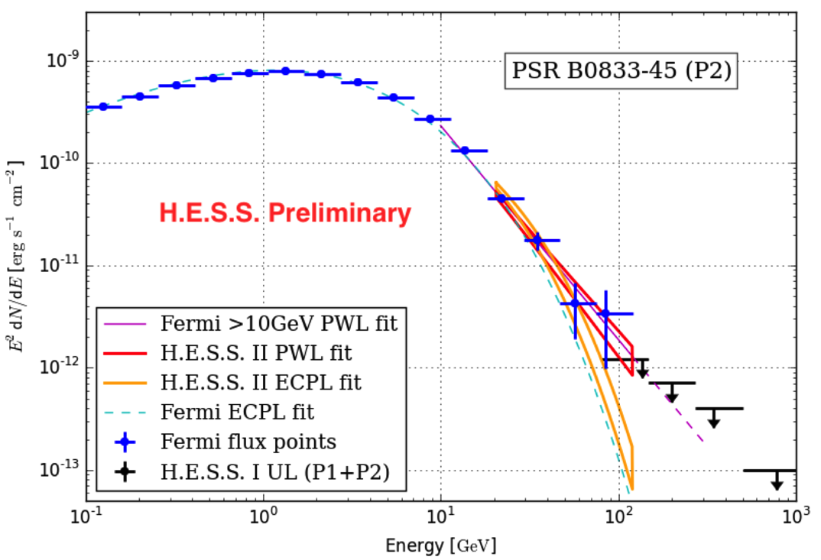
Crab and Vela pulsar
Crab by MAGIC
Broken power law
rather than cutoff PL.
At least Crab emission should be inverse Compton, rather than Curvature radiation.
1 TeV
Vela by HESS II
 | Γ₁ | E_{c} [GeV] | Γ₂
Crab | 2.0 | 5 | ~3
Vela | 1.5 | 3 | ~4
Geminga | 1.0 | 1 | ~5

Slide 15
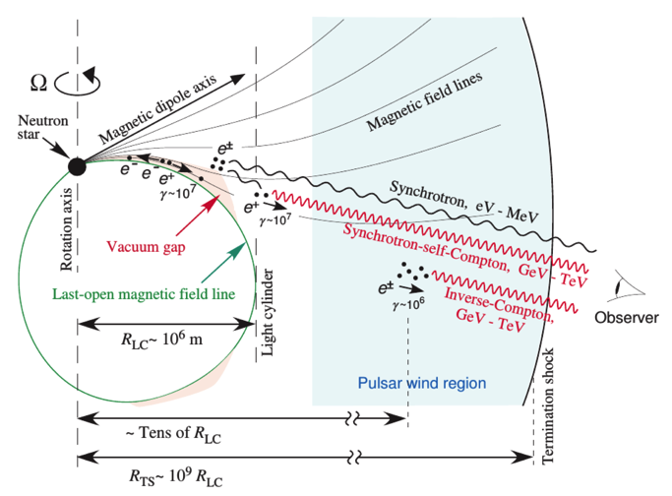
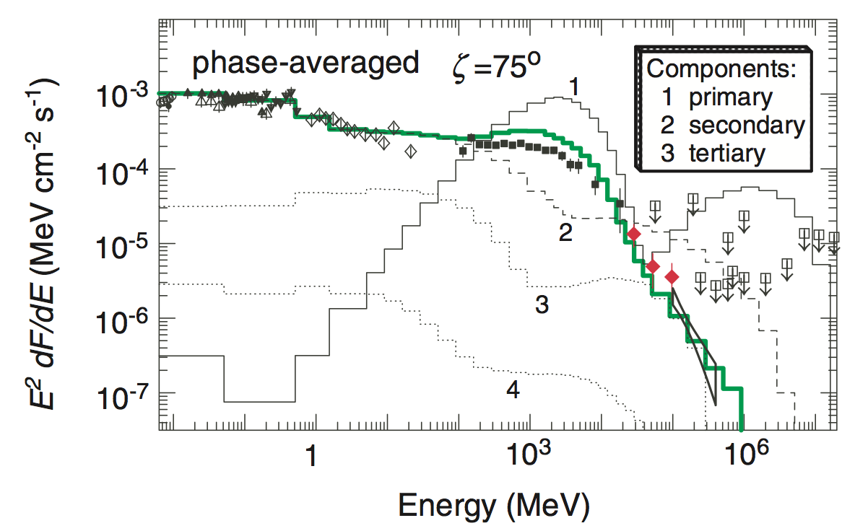
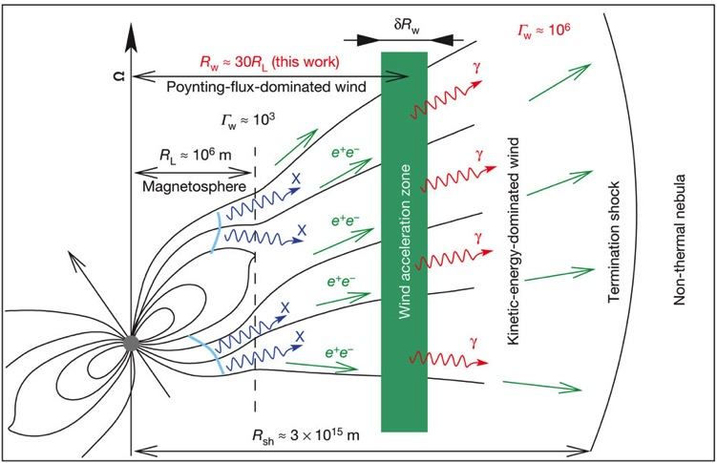
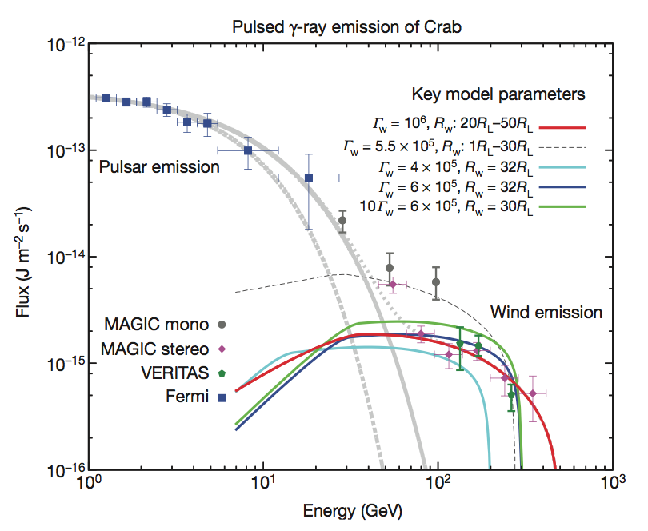
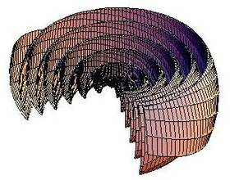
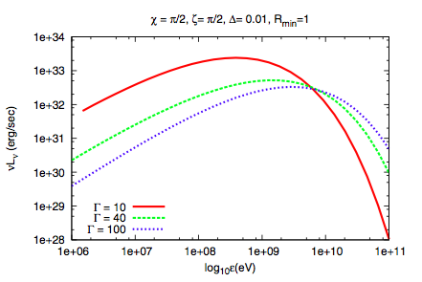
Newly Proposed Models
Magnetospheric cascades (K. Hirotani, ApJ 742, 2011)
10 TeV e -> IC -> absorbed
->EM cascade @ >Light Cylinder
Pulsar wind scattering
(F. Aharonian et al., Nature, 507, 2012)
kinetic dominated pulsar wind @ 50*LC
-> IC of pulsar X-rays
Striped wind
(e.g. Arka & DubusA&A 2013)
Emission from striped current sheet
Others

Slide 16
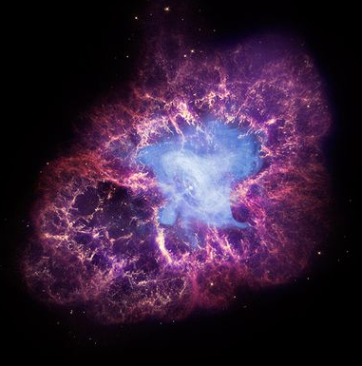
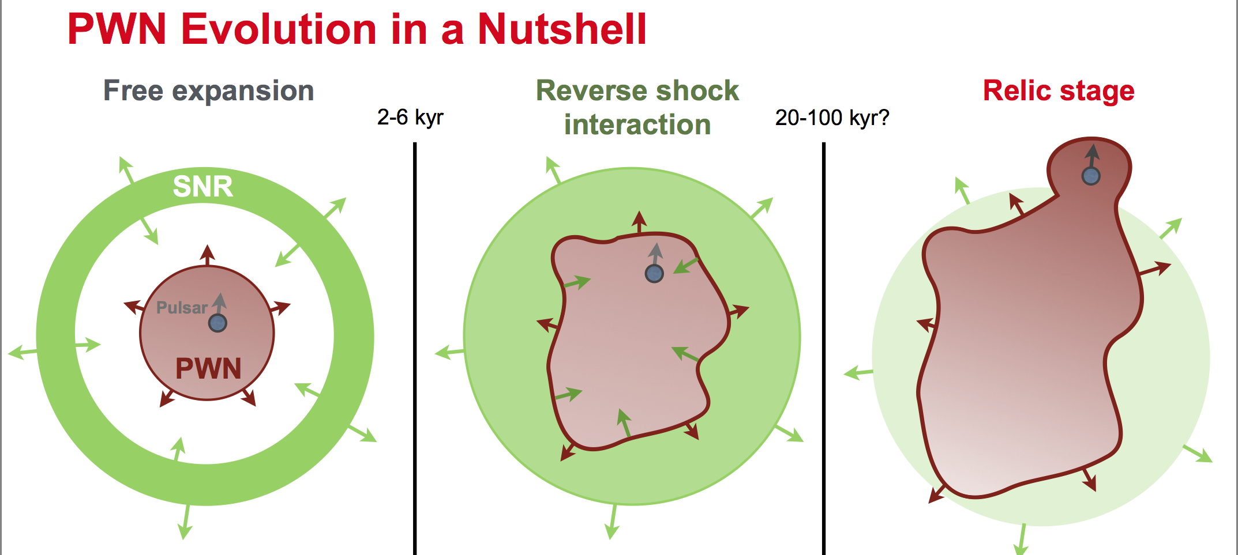
Pulsar Wind Nebula (34 detected)
Pulsar Wind Nebula: 7-80 known in the Galaxy
  Termination Shock of the pulsar wind
  Powered by the pulsar spindown
  Majority of galactic VHE sources
S. Klepsar, ICRC2015
Age | Phase | # of VHE srcs | Tev Source
0-7k yrs | Free Expansion? | 9 | Crab, G0.9
7k – 30 kyrs | Interaction? | 16 | CTA 1
>30 kyrs | Relic? | 9

Slide 17
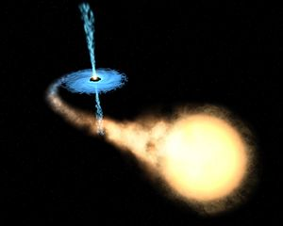
Binary (5 detected)
  X-ray binary (XB), 299 in the Galaxy.
  A binary system containing a compact object with matter accretion from the companion star
High mass X-ray binary (HMXB), 114 in the Galaxy
  XB with O or B type companion
Low mass X-ray binary (LMXB), 185 in the Galaxy
  The rest of XB
Microquasar, >15 in the Galaxy
  XB with relativistic jets. Some are LMXB, some are HMXB.
VHE Source |  | period | e | M_{comp}/M_{sun}
LS 5039 | Compact + O6.5V star | 3.9 days | 0.35 | 23
B1259 | NS + Be star | 3.4 years | 0.87 | 31
LS I 61 | Compact + Be star | 26.5 days | 0.55 | 12
HESS J1018 | Compact + O6V star | 16.6 days | -- | 31
HESS J0632 | Compact + B0V star | 315 days | 0.83 | 16
TeV J2032 | NS + Be star | 20-30 yrs | 0.94 | 10-20
All HMXB
Very old friend,
New categorization!?
(MNRAS 451, 2015)

Slide 18
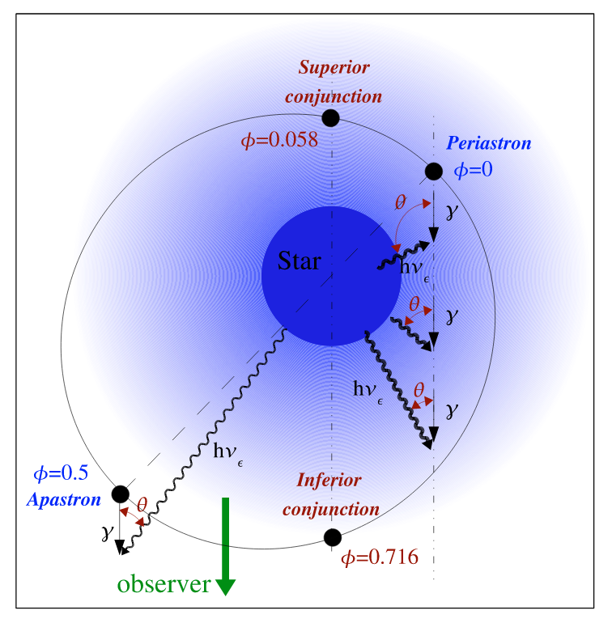
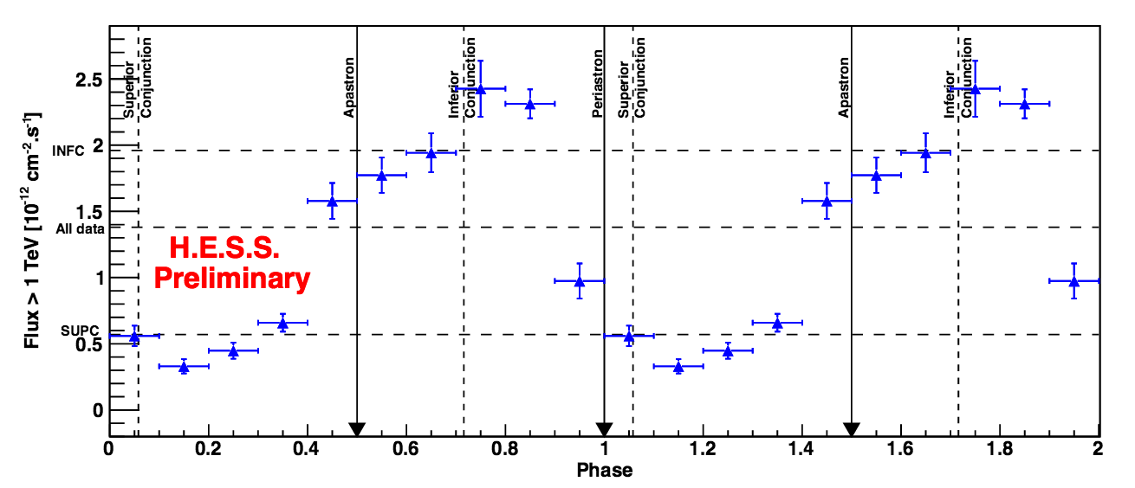
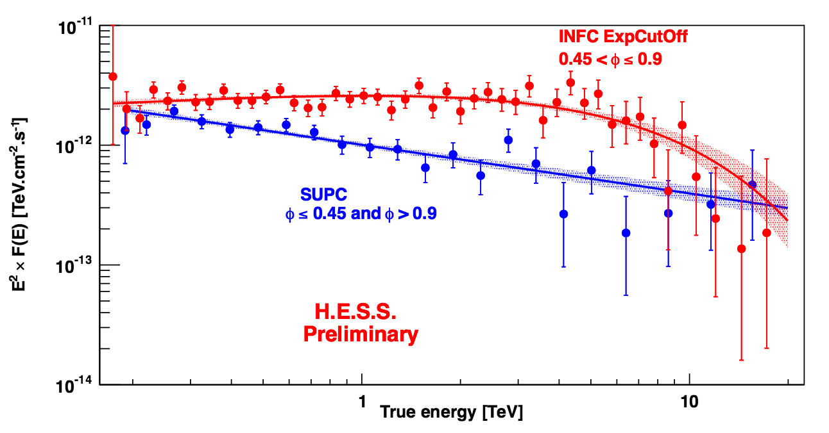

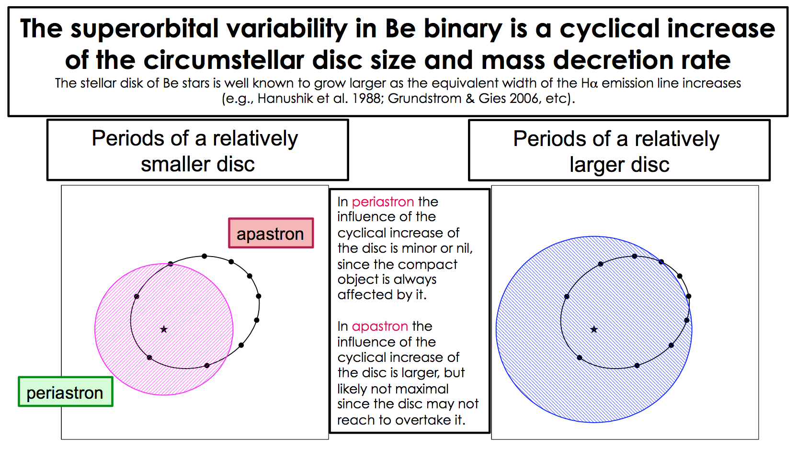
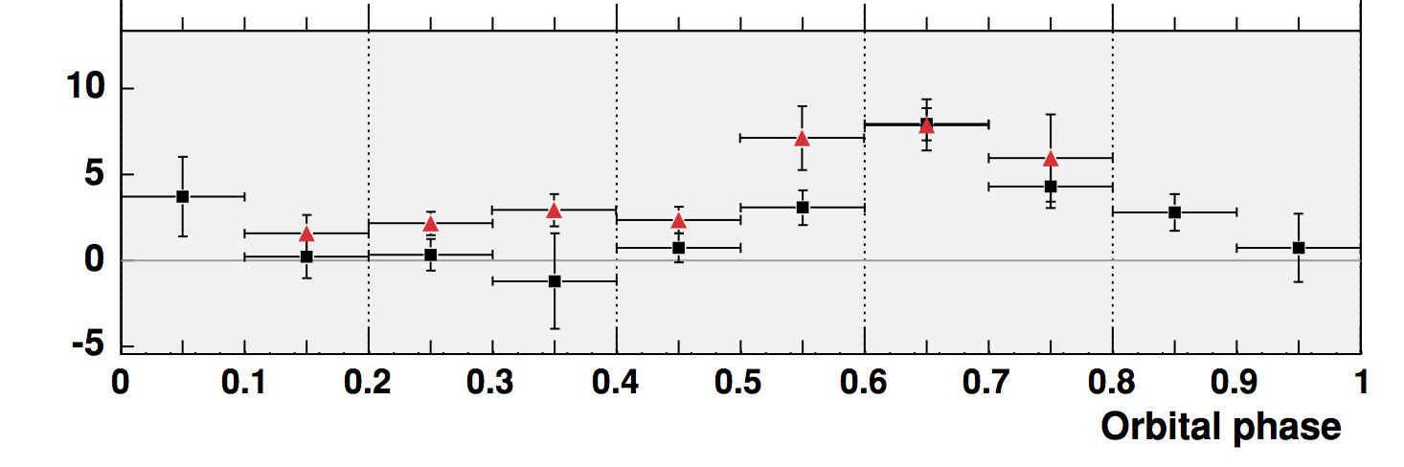
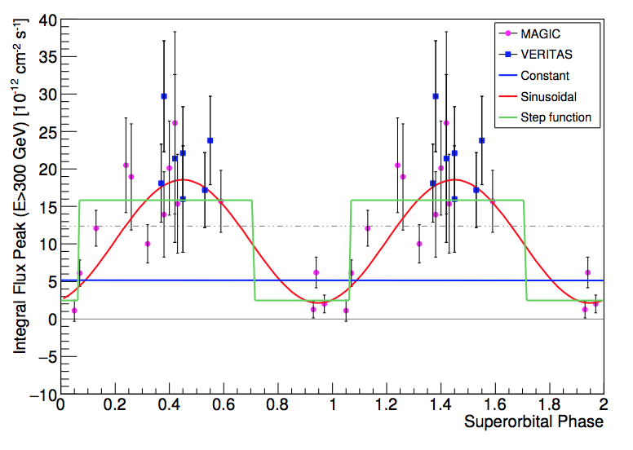
LS 5039 & LS I 61
LS 5039
<Flux vs orbital phase>
Orbital modulation is seen.
< SED vs orbital phase>
Orbital modulation is seen.
periastron
Apastron
LS I 61
<Orbital Modulation>
26.5 days modulation
= binary orbit modulation
Be star
pulsar
<Super-Orbital Modulation>
1670 days modulation
<Apastron flux vs superorbital phase>

Slide 19
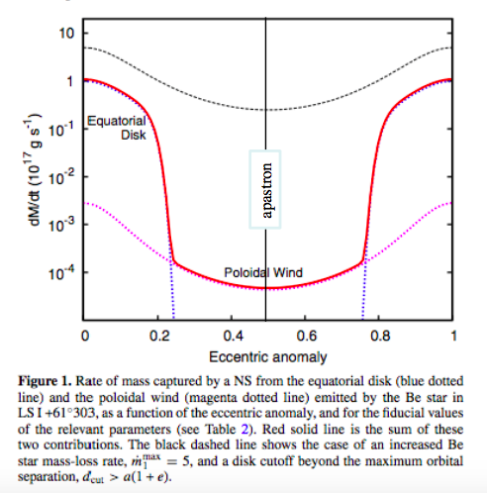
Super-orbital modulation of LS I+61
A possible scenario
Magnetic energy density
(dipole)
Accreting matter kin. energy density
(free fall)
(continuity)
Alfven radius (where mag = matter)
This disc oscillates with 1667 days
= superorbital period.
cm
〜R_{LC}
ejector state
propeller state
M=M_{sun}
B₀ ₌ 12G
Low accretion
R_{alfven} > R_{LC}
Pulsar Wind blow
Strong shock, & emission
High accretion
R_{alfven} < R_{LC}
Pulsar Wind disrupted
No shock, no emission
flip-flop

Slide 20
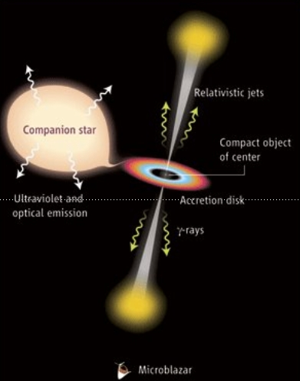
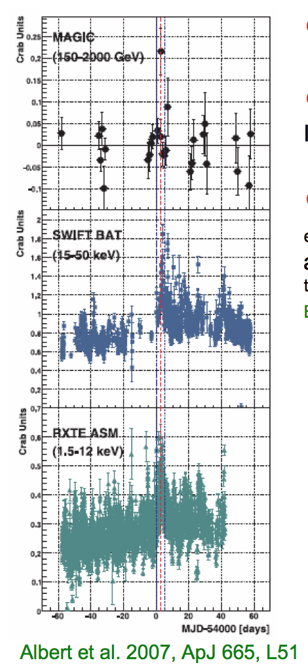
Microquasors
TeV emission expected from the Jets.
The following 4 are deeply observed by HESS, MAGIC and Veritas. None of them are detected.
  GRS 1915
  Cyg X-1
  Cyg X-3
  SS 443
Upper limits are a few % Crab level.
There was a 4 sigma hint of hourly scale flare from Cyg X-1 reported by MAGIC

Slide 21





Stellar/globular clusters (5 detected)
Massive Stellar Clusters (4 srcs)
Globular Cluster: Tarzan 5
Westerlund 1
HESS J1614
Westerlund 2
HESS J1848
Massive Steller cluster can accelerate particles by
  Colliding winds
  Collective wind bubble
  SN explosions
It is not clear which mechanism is at work for each system
The only VHE GC.
Extended large than the GC tidal radius
4 arcmin offset from the GC center
Millisecond pulsars in GC produce leptonic VHE?

Slide 22
Conclusion
The origin of Galactic Cosmic-rays is being gradually understood, but not yet fully.
Many different types of objects emit TeV gamma-rays with different mechanisms. TeV gamma-ray observations are very useful and powerful for galactic astrophysics.

Slide 23




Population Study
Young Energetic pulsar
has Nebula
S. Klepsar, ICRC2015
Interaction
Free expansion
Edot vs Age
TeV Extension vs Age
TeV Luminosity vs Edot
Correlation is not clear, but more or less consistent with theory.

Slide 24




Crab and 3C58
Crab
3C58
Precision measurements
Peculiar PWN
MAGIC, JHEA 5, 2015
Curved spectra measured up to 20 TeV
Existence of the cutoff unclear due to systematics
Uniform B field (time dep/indep) cannot reproduce the spectrum precisely.
Spectral enhancement during GeV flare is not detected.
Young (τ=5kyr) and energetic (log10(Edot) = 37.5, 10% Crab)
Lowest VHE luminosity
Most inefficient conversion to VHE
Conversion to X-ray is OK

Slide 25


Galactic Center
Apart from Sgr A* and G0.9,
Point-like source coinciding with radio arc
  PWN?
0.1 degree source at GC
  Radial gradient of CR in central molecular zone?
Diffuse emission tracing CS line
Large Scale diffuse emission
Sgr A* spectrum shows cutoff at 10 TeV, while diffuse emission shows no cutoff.
G0.9
Sgr A*
Radio arc

Slide 26


LS 5039 & PSR B1259
LS 5039
<Flux vs orbital phase>
Orbital modulation is seen.
< SED vs orbital phase>
Orbital modulation is seen.
Modulation can be explained by photosphere absorption.
PSR B1259
<Flux vs orbital phase>
Two peaks near priastron.
Two peaks can be explained interaction between pulsar wind and inclined circumstellar disc.

Slide 27
Diffusive Shock Acceleration
Shock velocity
Larmor radius
Super-simplified
Free expansion phase
Sedov Taylor phase
Acceleration efficiency is highest during Free expansion phase (< 100 yr)
Maximum attainable energy is attained at the transition time to Sedov Phase
During Sedov phase, efficiency decays in time.
Possible Pevatron!

