Slide 1
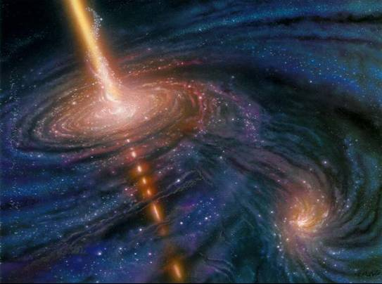
VHE Gamma Ray Astronomy Present results
ICRR, University of Tokyo
Max-Planck-Institute for Physics
Masahiro Teshima

Slide 2
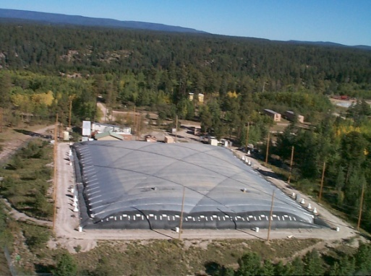
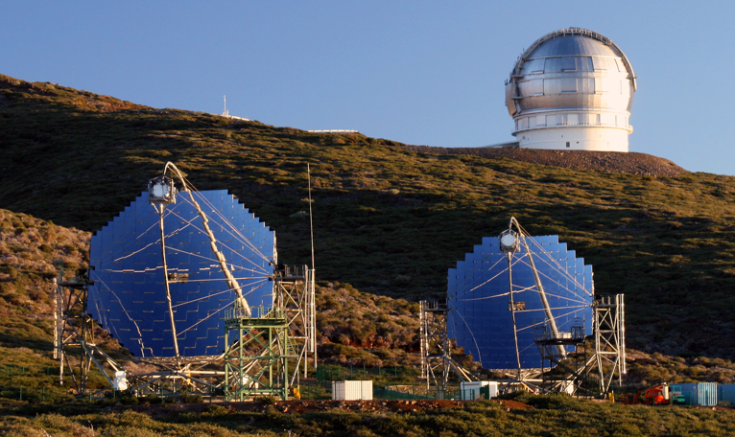
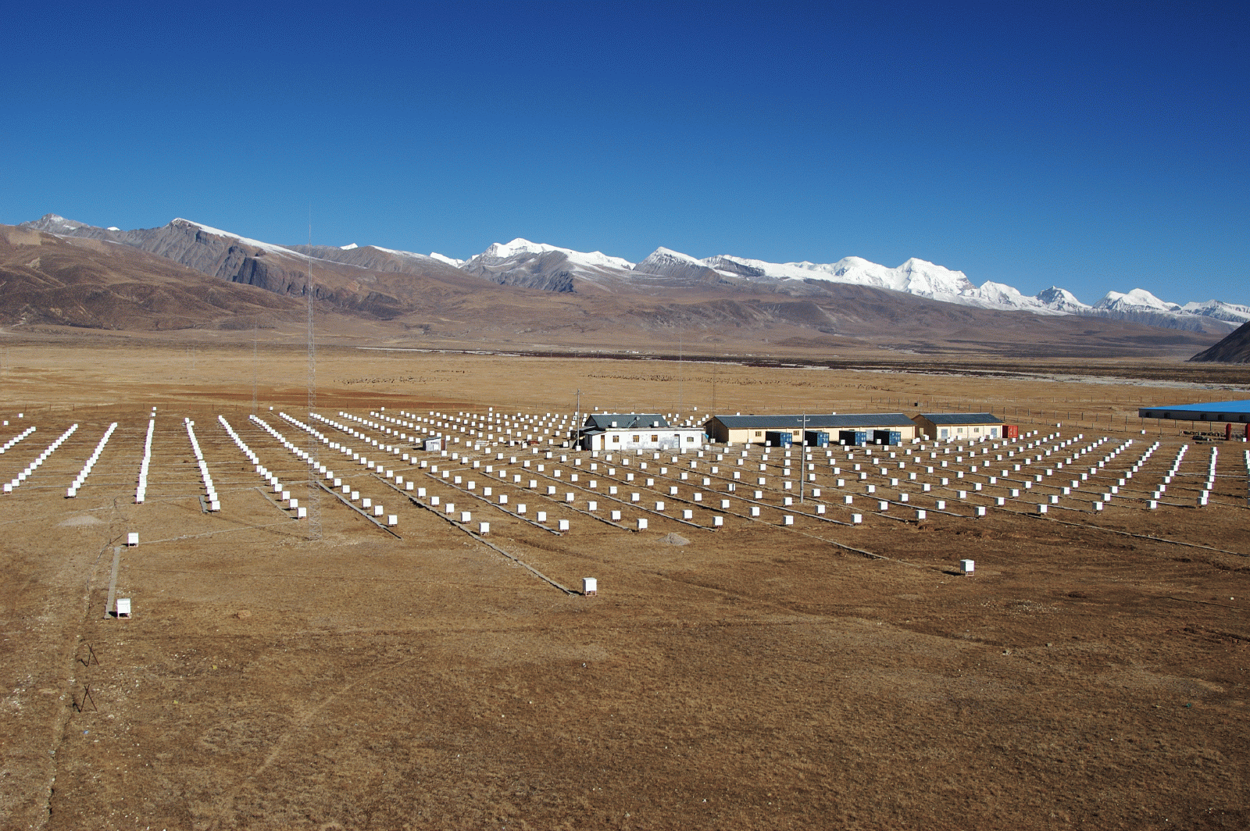
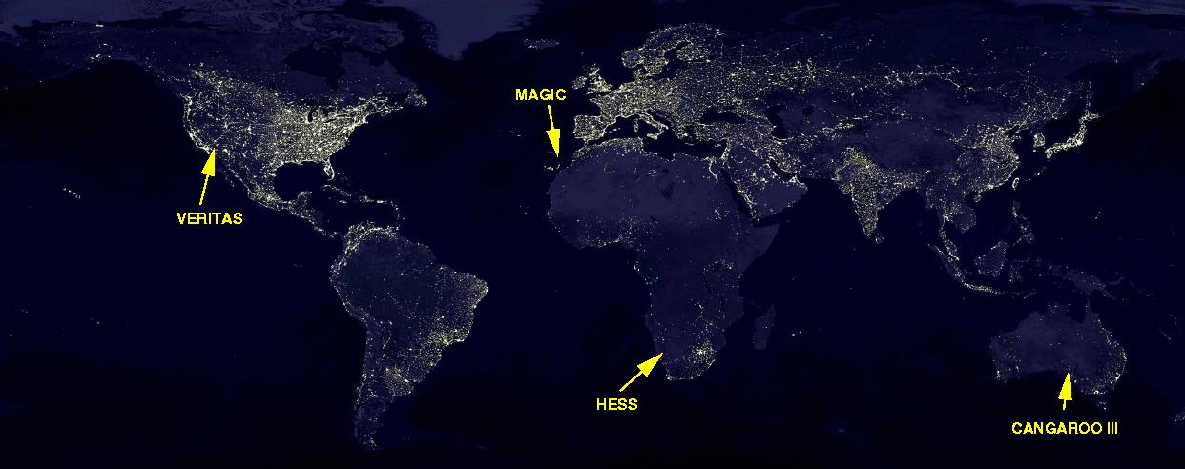
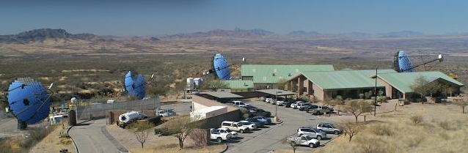
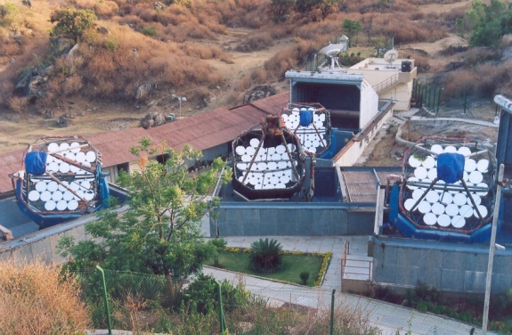
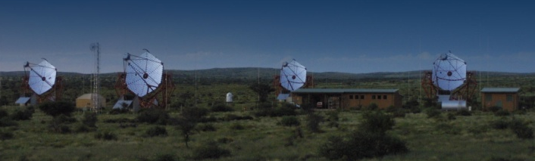
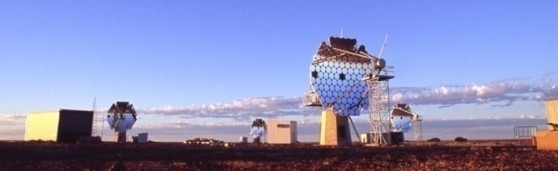
VHE Instruments
MILAGRO
MAGIC
TIBET
TIBET
ARGO-YBJ
MILAGRO
STACEE
TACTIC
VERTAS
PACT
GRAPES
TACTIC
HESS
CANGAROO
Notes:
2

Slide 3
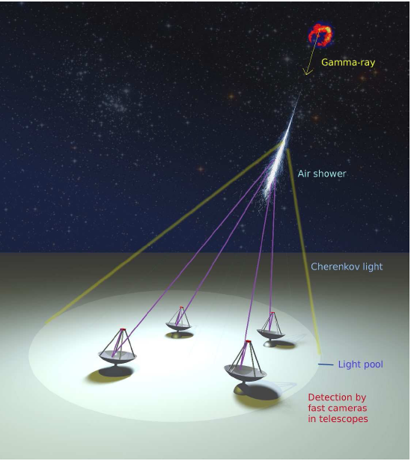
Imaging Air Cherenkov Telescope
Cherenkov Light
50photons/m² (5 pe/m²) at 1TeV
➔ MAGIC 2 x240 m², HESS 4 x106 m²
T1
T２
T３
T４
Typical parameters
Energy range 50GeV ~ 10TeV
CR rejection power >99%
Angular resolution ~0.1 degrees
Energy resolution ~20%
Detection area ~10⁵m²
Sensitivity ~1% Crab Flux (10⁻¹³ erg/cm²s)

Slide 4
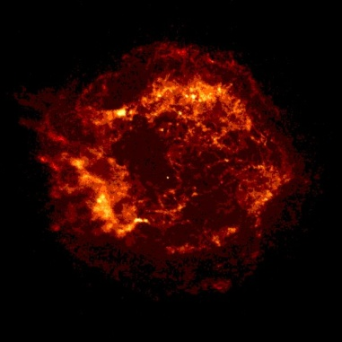
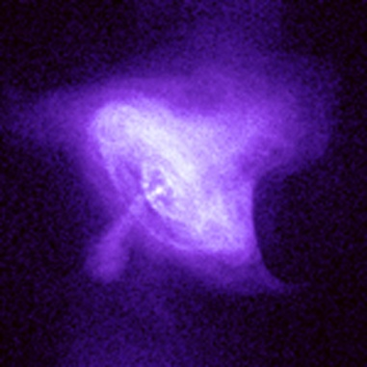
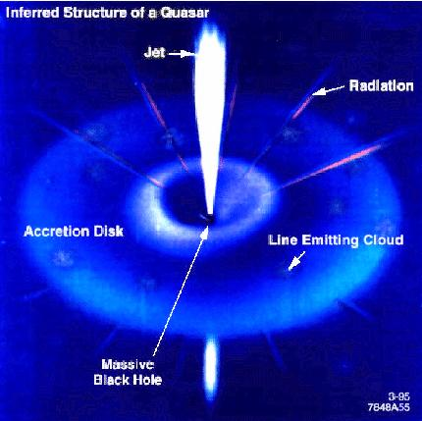
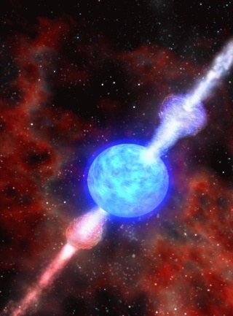
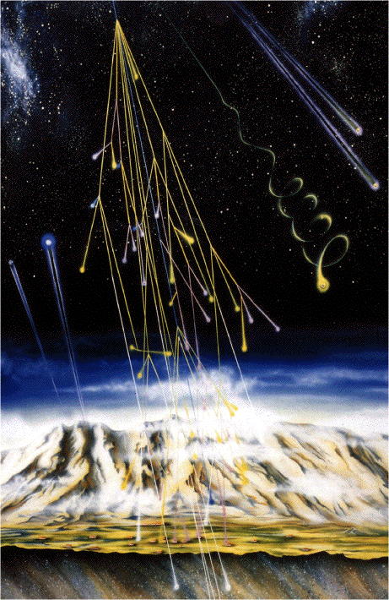
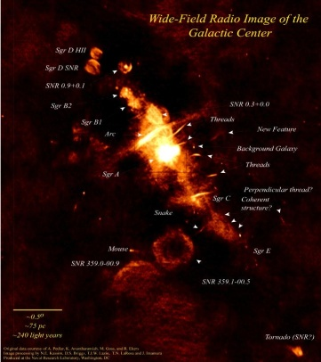
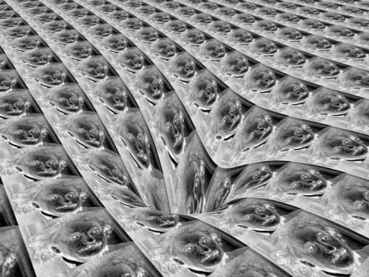
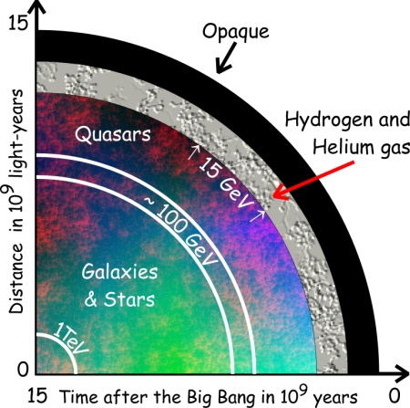
Physics objectives
SNRs
Pulsars
and PWNe
Micro quasars
X-ray binaries
AGNs
GRBs
Origin of
cosmic rays
Space-time
& relativity
Dark matter
Cosmology

Slide 5
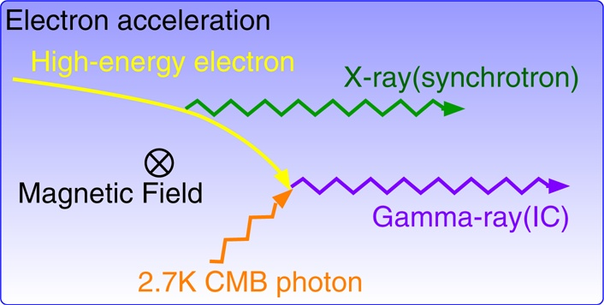
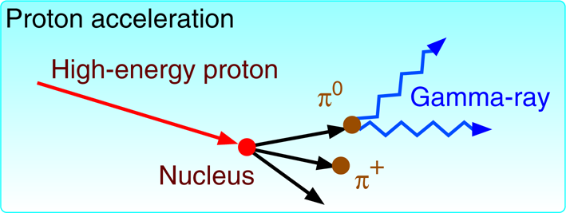
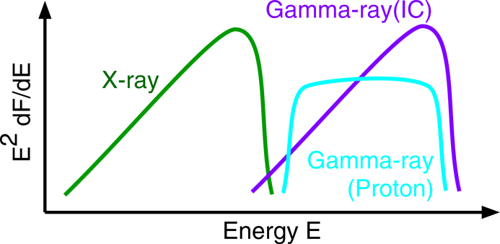
Gamma-Ray Emission Processes(1)
Astrophysical process

Slide 6
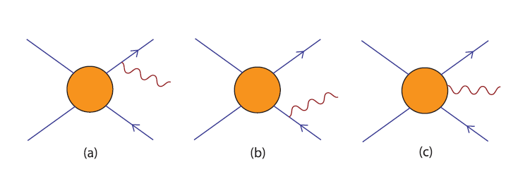
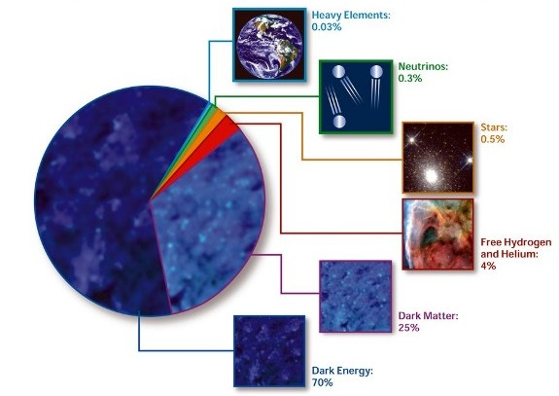
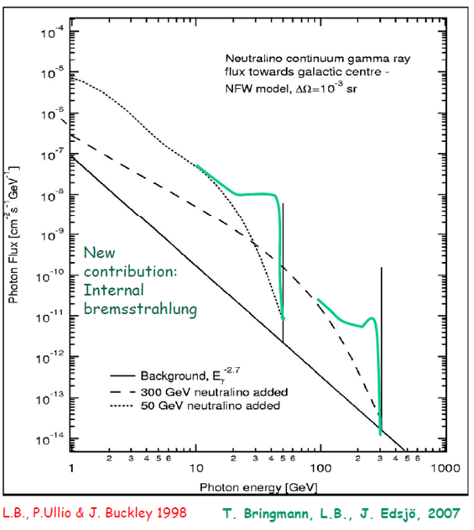
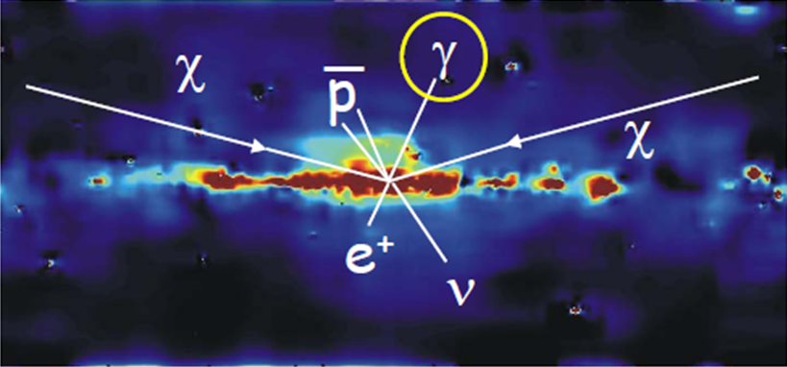
Gamma ray emission process from DM Annihilation
Dark Matter Annihilations
Bergstrom et al.

Slide 7
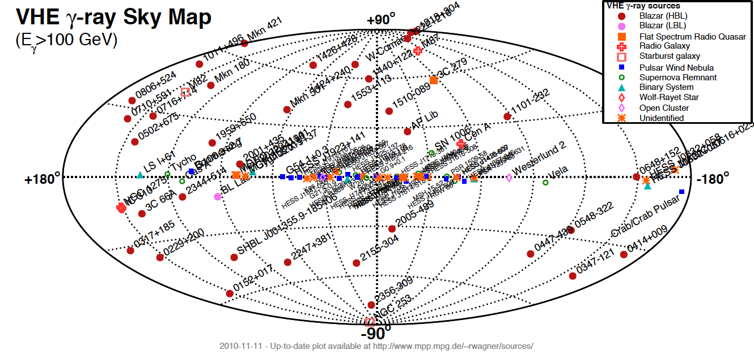
VHE Skymap
106 sources (45 Extragalactics + 61 Galactics) in Nov 2010
Blazars, FSRQs, FR-I, Starburst galaxies SNRs, PWNe, Pulsar, Binaries, un-IDs

Slide 8
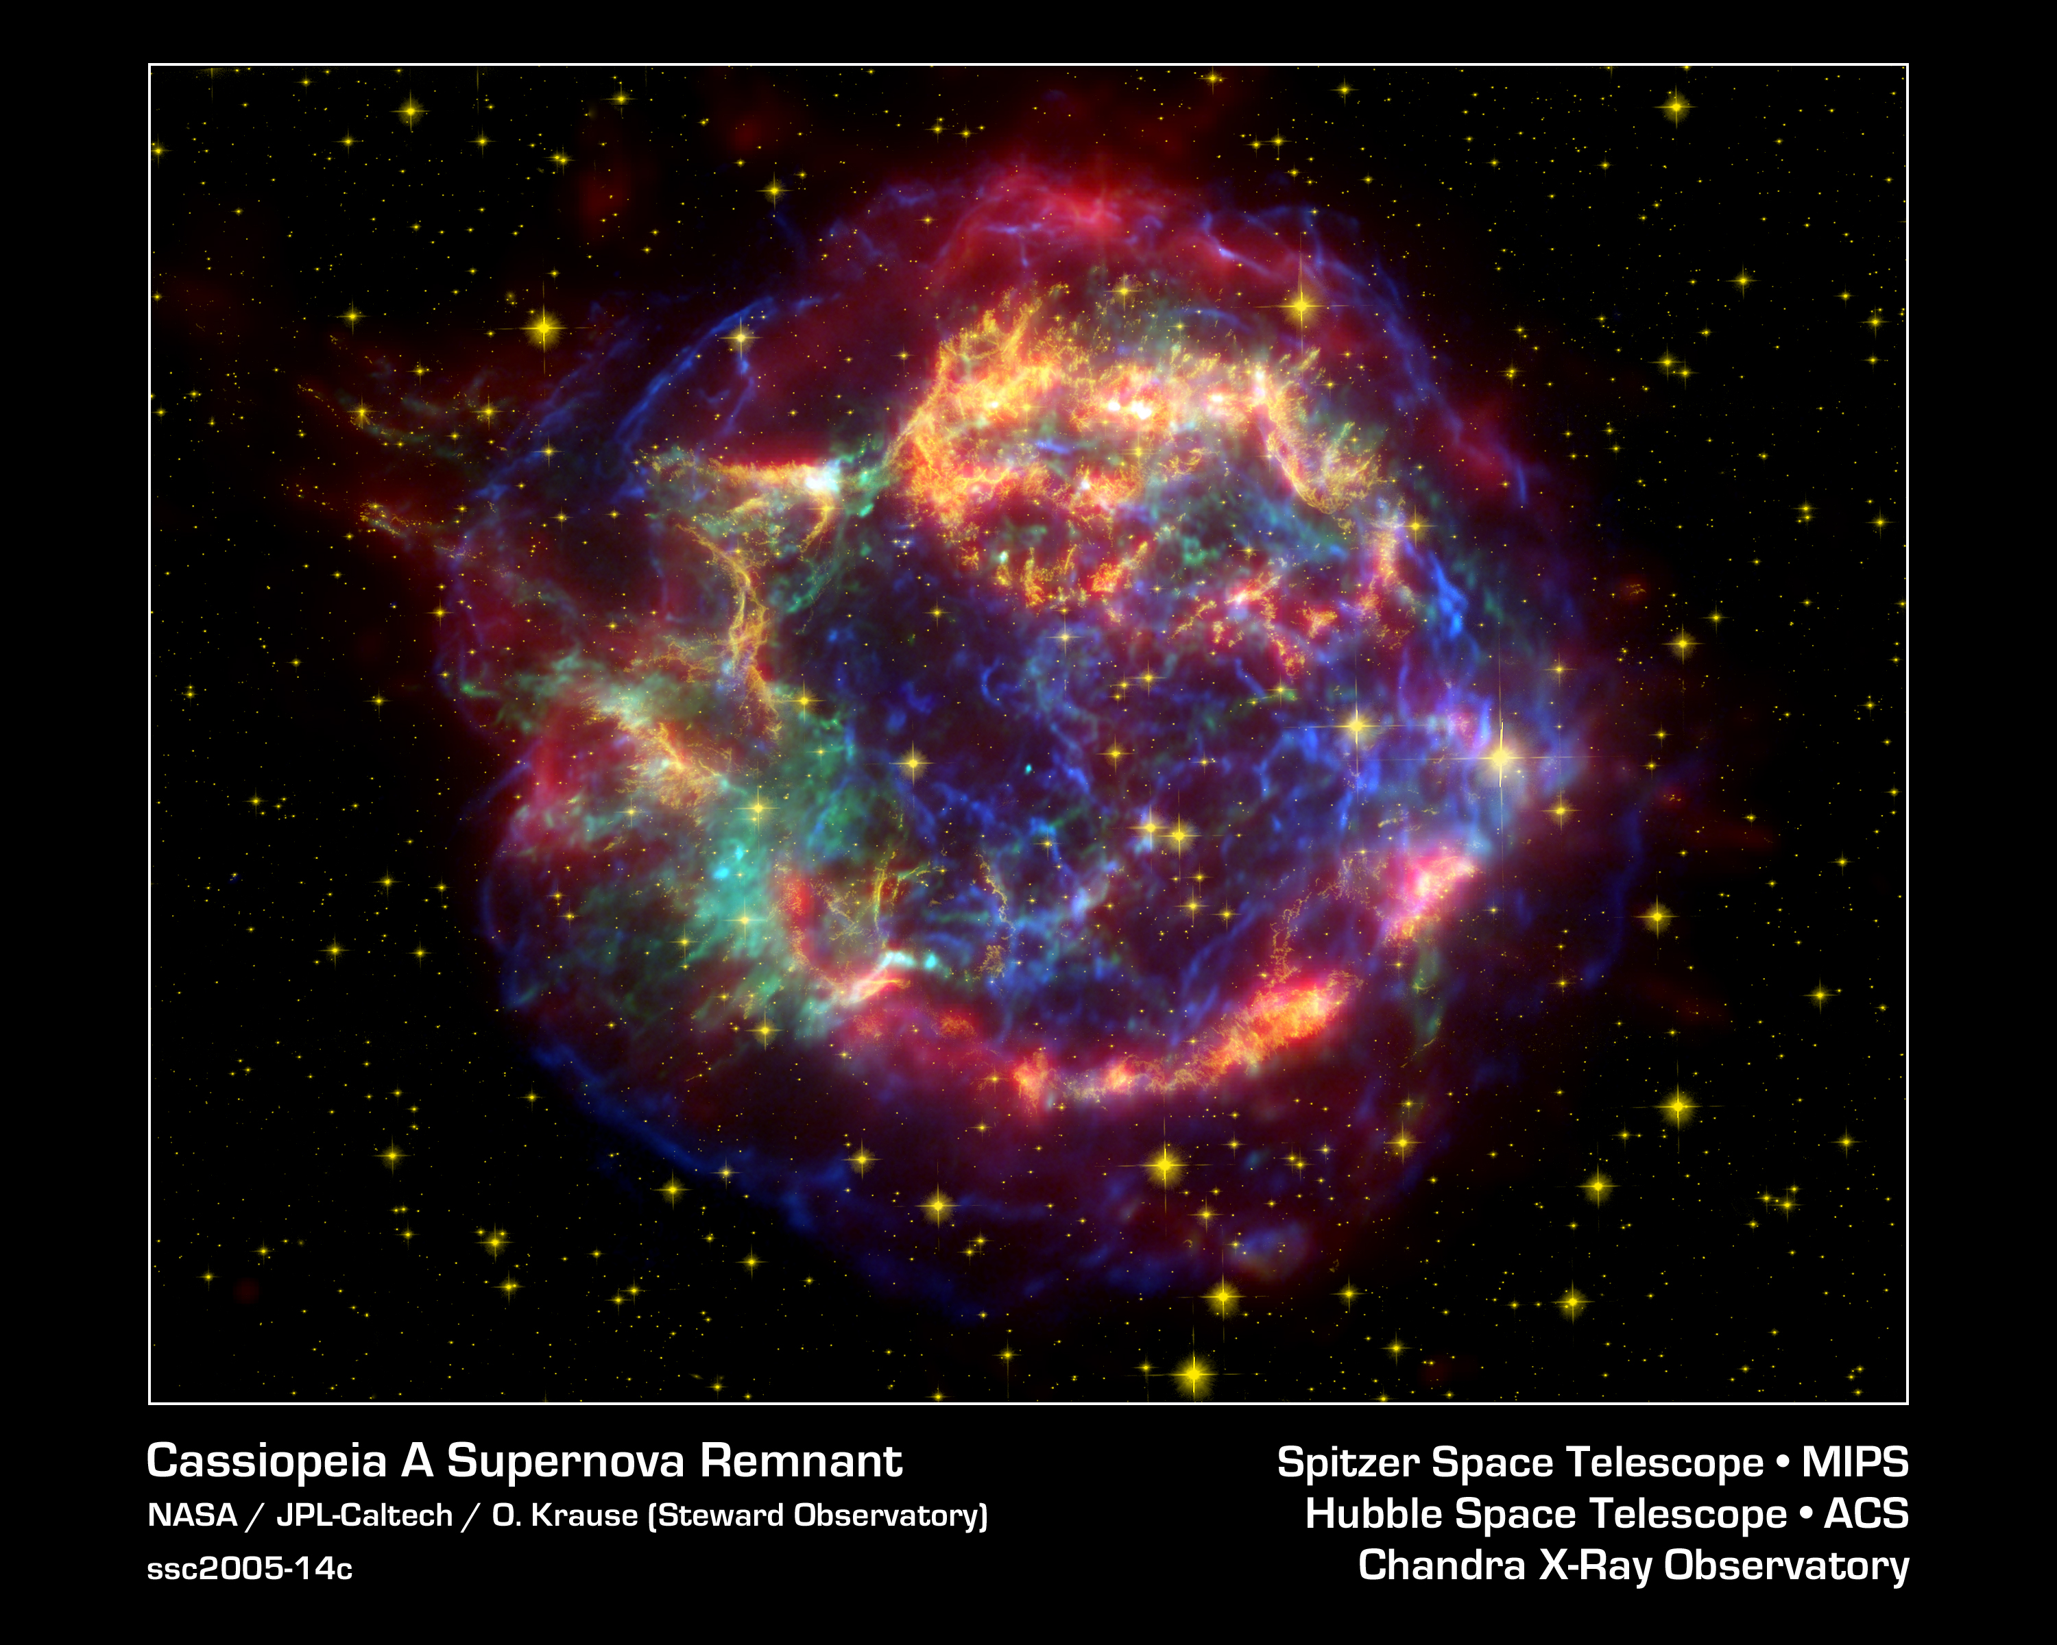
Galactic Sources
SNRs, PWNe

Slide 9
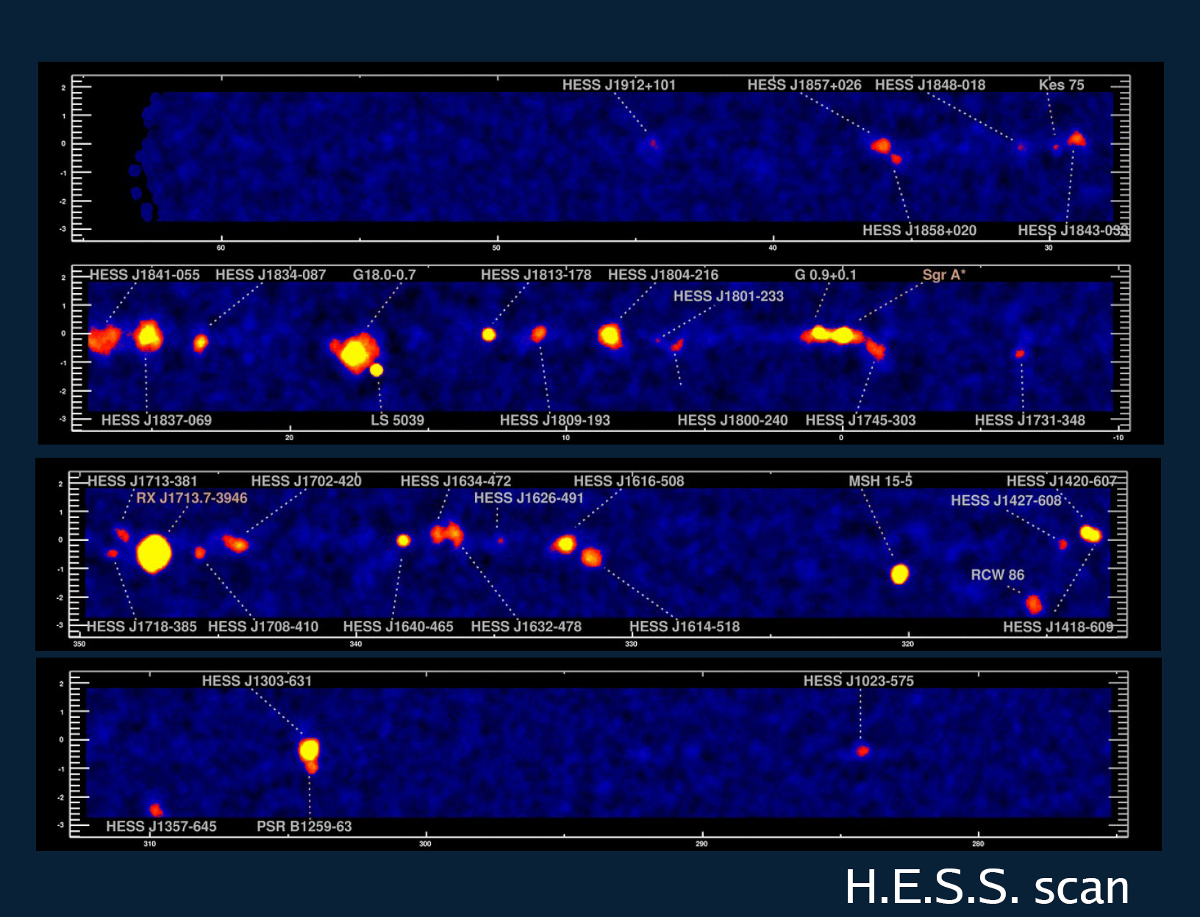
Great success!! HESS galactic plane survey
PWNe, SNRs, Binaries, un-IDs

Slide 10
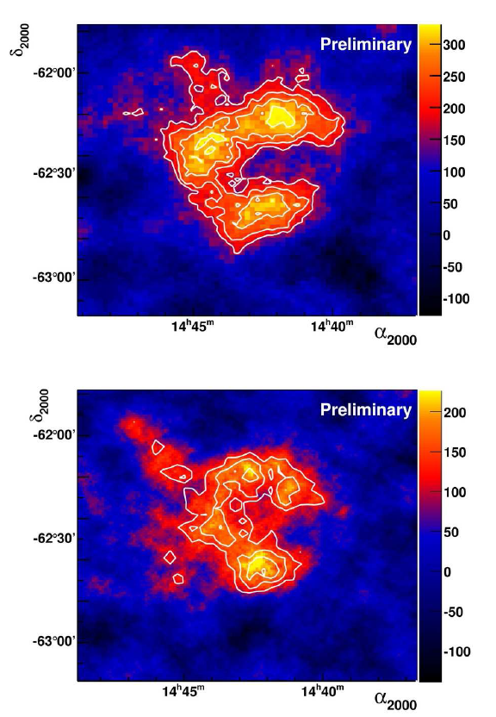
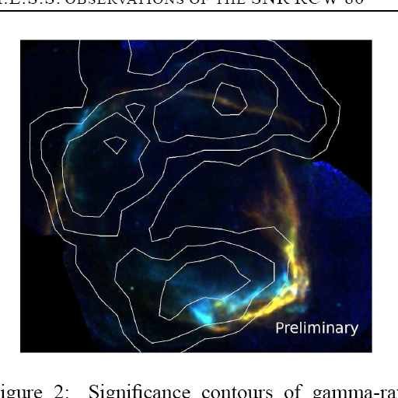
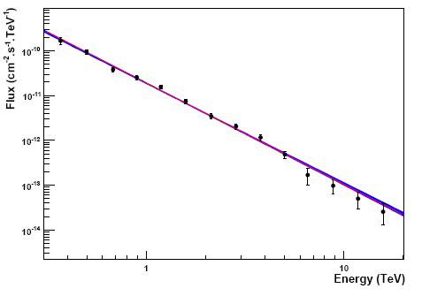
HESS: Shell type SNRs(7)
RX J1713, RX J0852, RCW86
HESS
HESS
HESS RCW86
Index ~2.0
Break ~20TeV
Index ~2.2
XMM-Newton, HESS

Slide 11
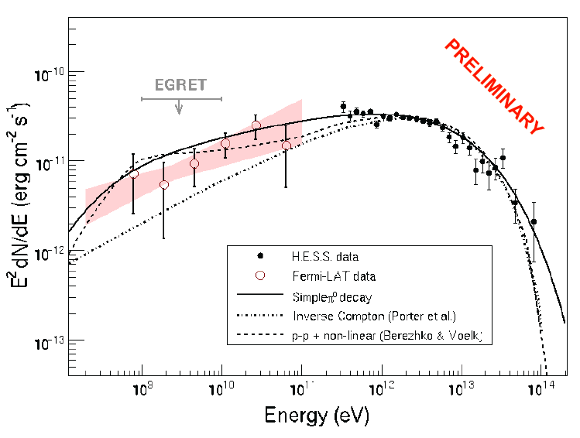
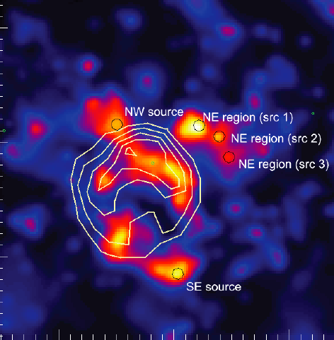
SNR Study
RX J1713 HESS + Fermi
Color HESS observation
Contour Suzaku X-Ray
Concaved spectrum (non-linear effect)??
Fermi

Slide 12
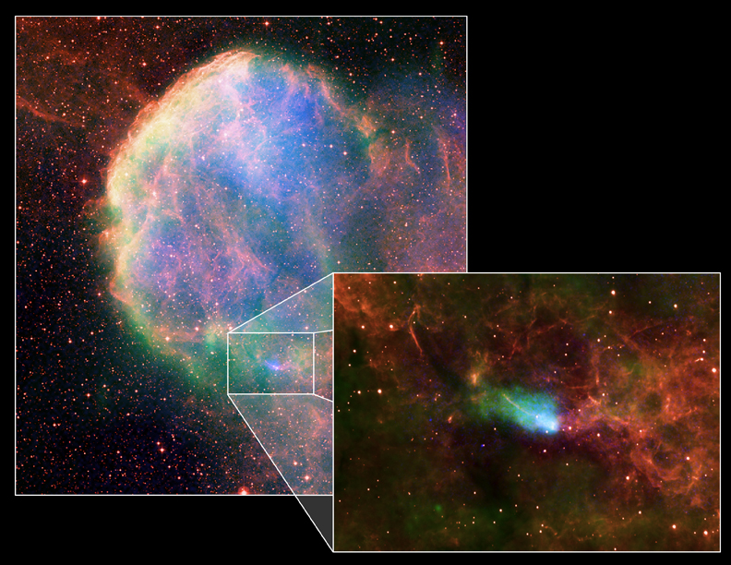
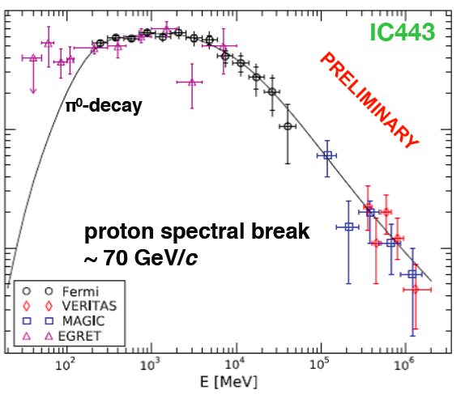
Shell type SNRs
IC443(MAGIC J0616)
Composite image
With X(Chandra),
Radio(VLA),
Optical (DSS)
MAGIC J0616
CXOU J061705.3+222127
index~3.1
Molecular Cloud
Radio
X-ray
EGRET 3EG J0617+2238
Pulsar CXOU J061705.3+222127

Slide 13
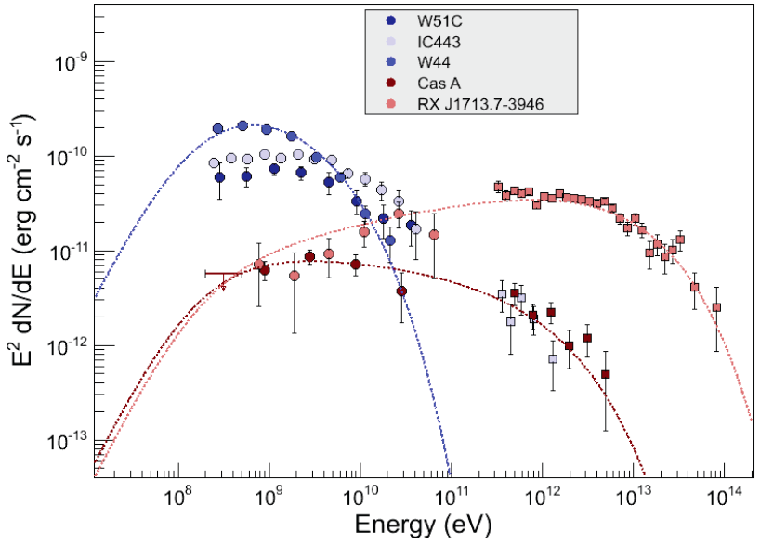
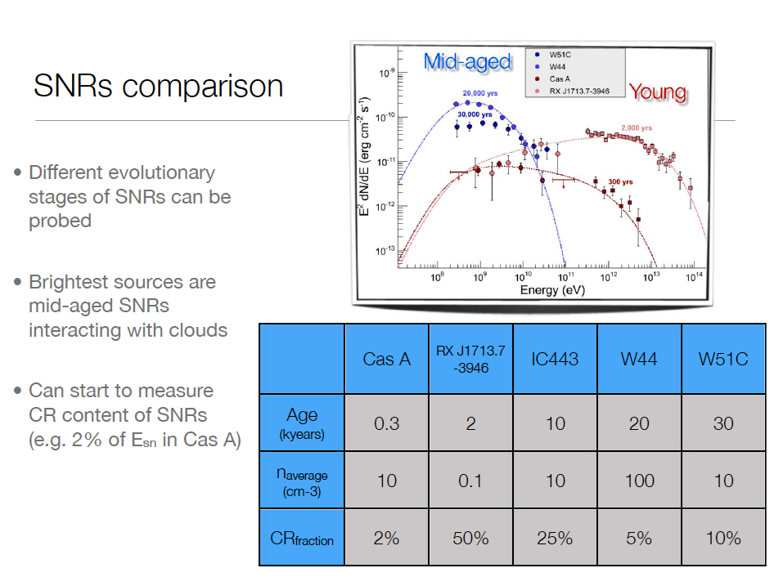
SNRs in different evolutionary stages
We can study SNRs in different
evolutionary stages
Courtesy of S.Funk

Slide 14
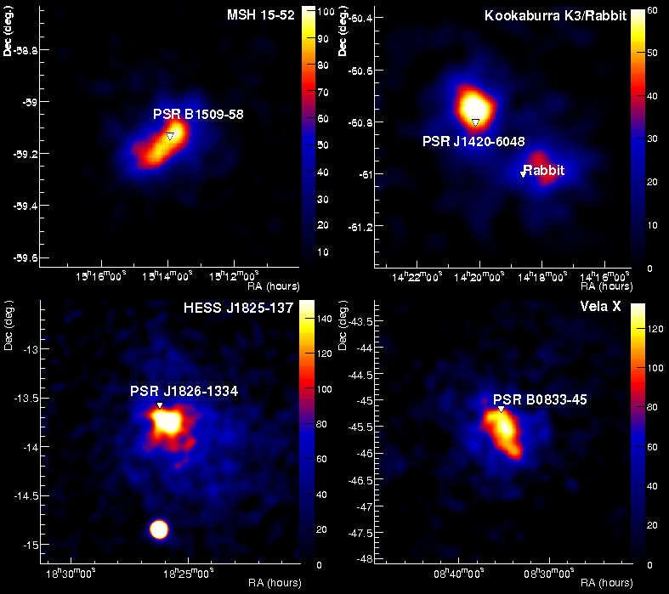
Pulsar Wind Nebulae observation by HESS
Major galactic TeV source population
  Associated with relatively young (<10⁵ year old) and energetic pulsars
Generally believed that we see inverse Compton emission of 1-100 TeV electrons
1% of Spin-down energy goes to VHE gamma rays
Funk 2006
Notes:
14

Slide 15
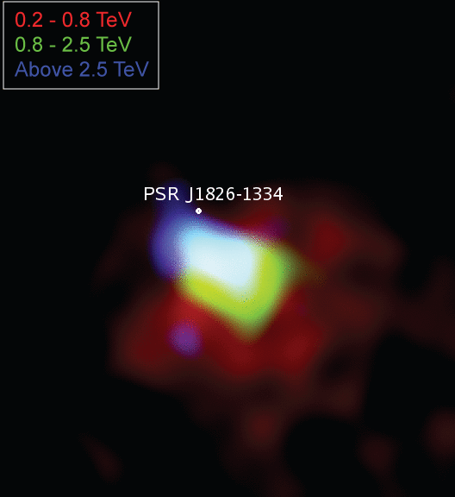
Pulsar Wind Nebula HESS J1825-137
Energy Dependent Morphology
Major galactic TeV source population
  Associated with relatively young (<10⁵ year old) and energetic pulsars
Generally believed that we see inverse Compton emission of 1-100 TeV electrons
1% of Spin-down energy goes to VHE gamma rays
Clear evidence for cooling of electrons in the Nebula
Notes:
15

Slide 16
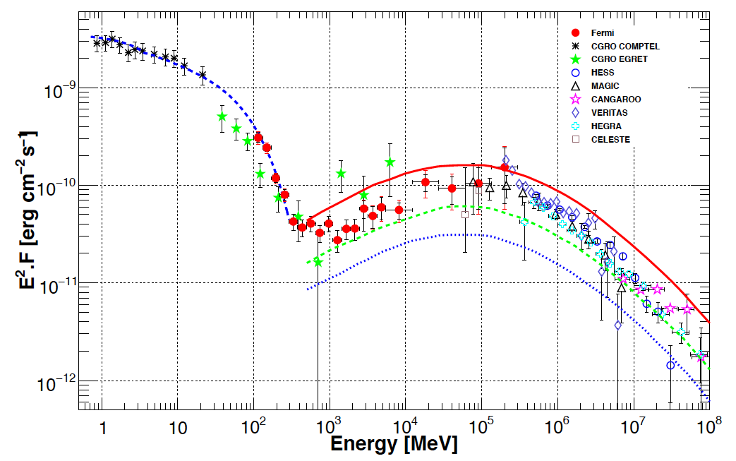
Crab Nebula
Synchrotron and Inverse Compton components
Synchrotron
Inverse compton
CTA

Slide 17

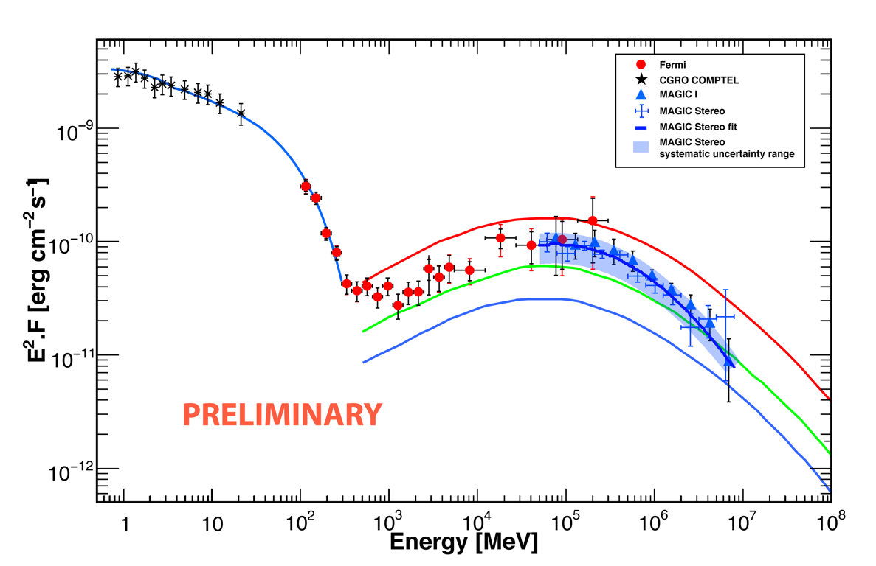
Crab Nebula spectrum
Fermi and MAGIC-Stereo
Smaller error bars
in only 3.5 hours

Slide 18
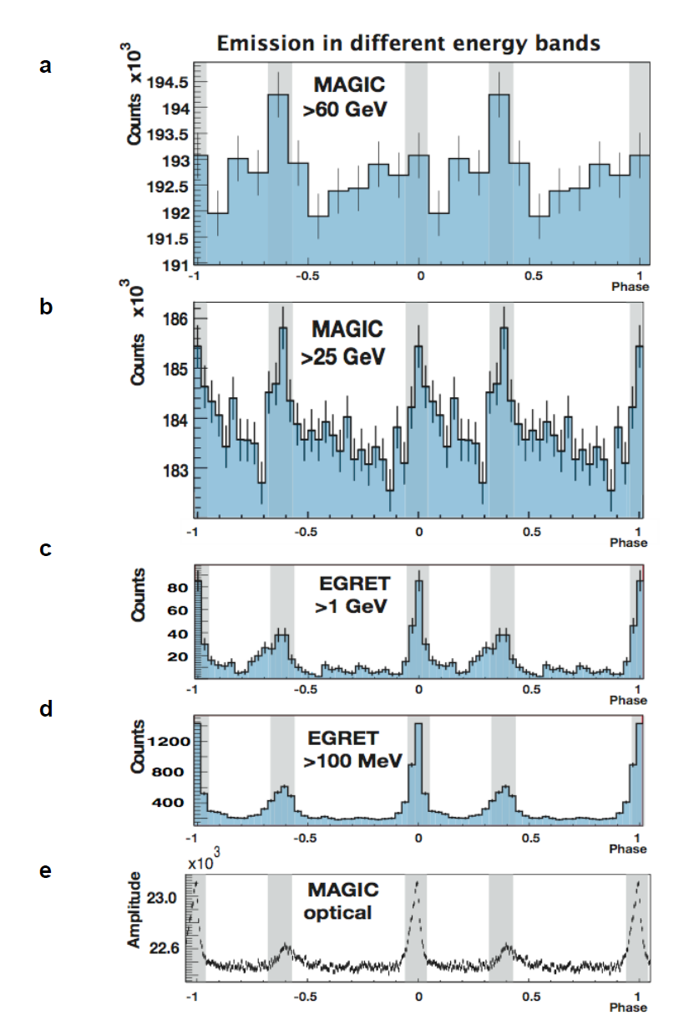
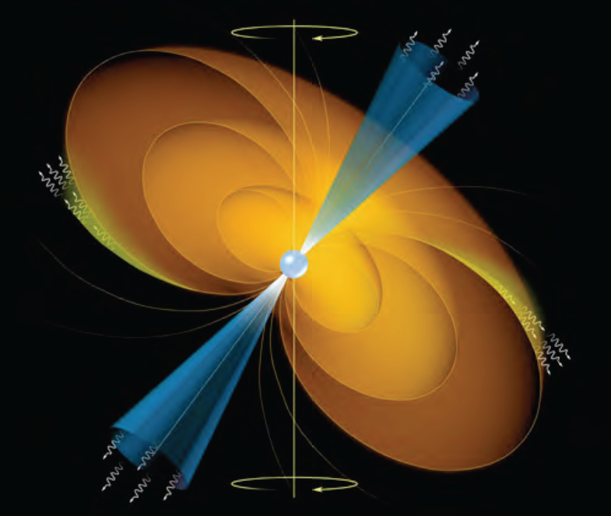
Pulsar Study
MAGIC result: Published in Science in 2008
By measuring the spectrum around cutoff
or at high energies is important to distinguish
the emission model
Polar cap: double exponent
Outer gap: simple exponent

Slide 19
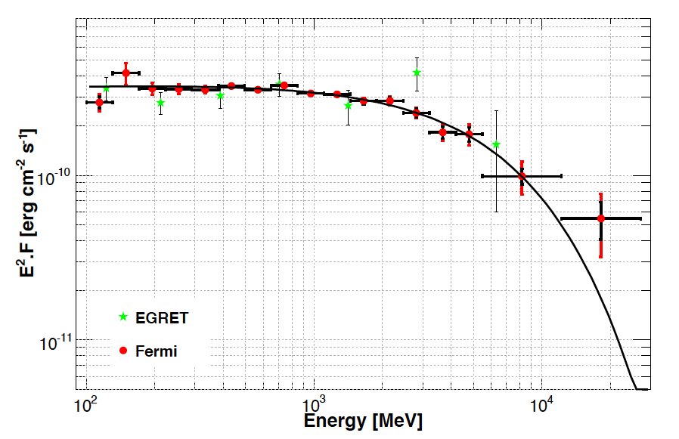
Crab Pulsar
Cut off feature of Spectrum: Exponent or Power-Law
EGRET
Fermi
MAGIC
CTA Extrapolated

Slide 20
Extragalactic sources

Slide 21
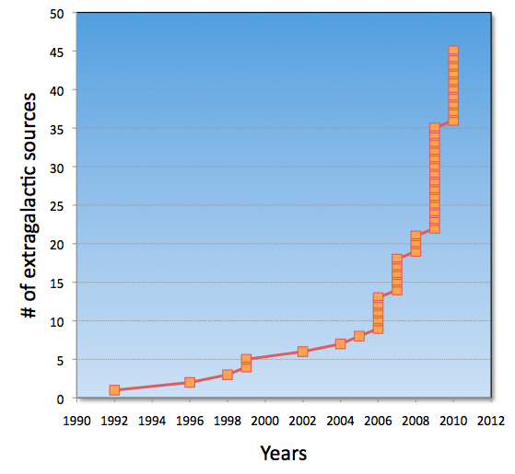
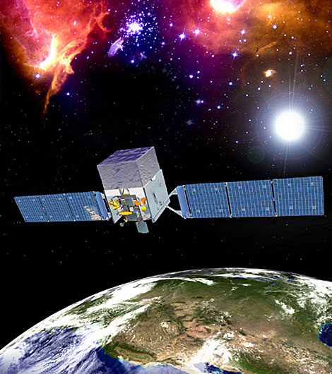
Number of extragalactic VHE Sources (45)
HESS
MAGIC
VERITAS
MAGIC
Whipple
HEGRA
HESS
FERMI
VERITAS
1ES1959
PKS2155
M87
Mrk 421
Mrk 501
1H1426
1ES2344
Fermi

Slide 22
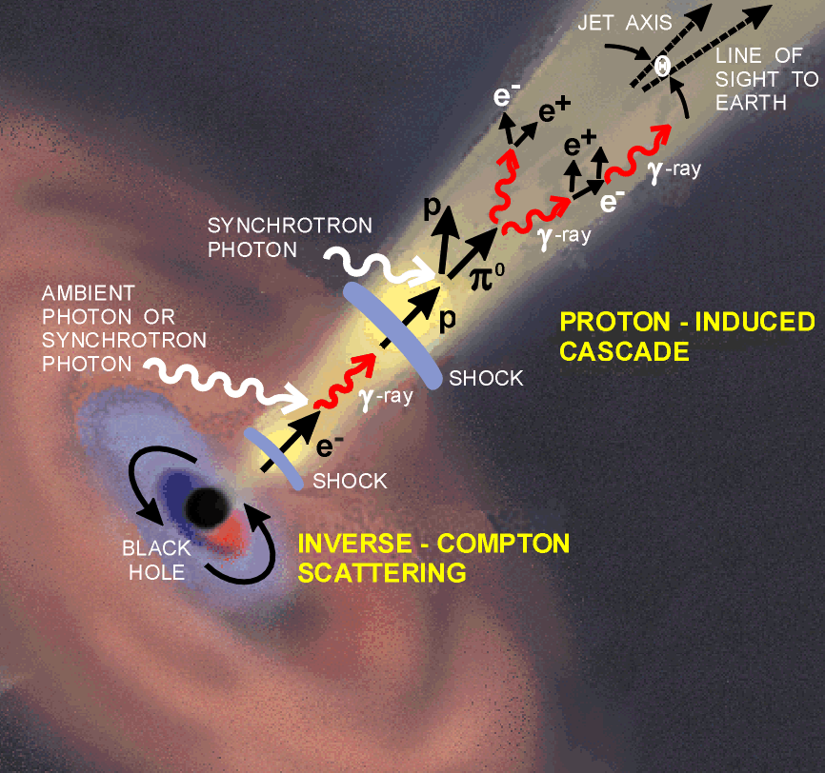
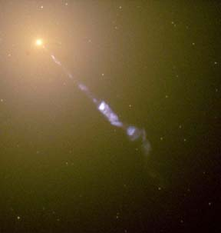
Cosmic Ray accelerator
Active Galactic Nuclei
FRI, FRII
Blazars
Gamma factor ~10
SMBH 10⁷-10¹⁰ M◎
M87 (HST)

Slide 23
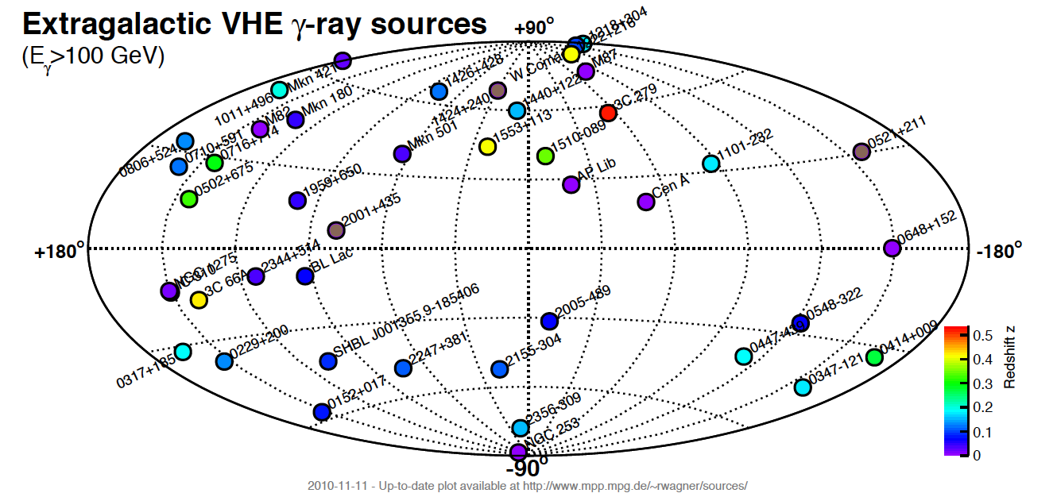
Extra-galactic sources
45 sources ( 3 x FR-I, 2 x Starburst galaxies, 4 x FSRQs, 36 BL Lacs )

Slide 24
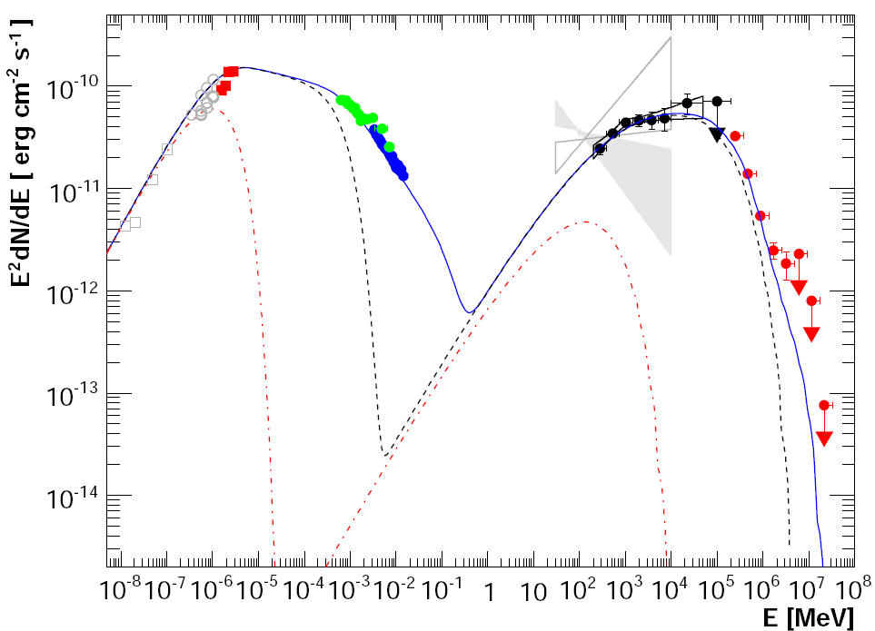
PKS 2155−304
Spectral Energy Distribution
Time-averaged SED is well described by a single zone SSC model:
Fermi
ATOM
RXTE
FERMI
Swift
HESS
Highest energy electrons (γ_{e}>2×10⁵) produce the X-ray emission, but contribute relatively little above 0.2 TeV

Slide 25
Mrk421 MWL SED

Slide 26






EBL (Extragalactic Background Light)
Extragalactic Background Light
blazar
IACT
γ_{VHE}
γ_{EBL}
e⁺
e⁻

Slide 27

EBL upper limit by MAGIC and HESS observations

Slide 28



M87 flare in 2008:
MAGIC, VERITAS, HESS, VLBA
Model of 43GHz Radio flux
using the measured VHE gamma flux

Slide 29


M87 flare in 2008:
MAGIC, VERITA, HESS, and VLBA
2.5mas (0.25pc)
20” (2kpc)
30mas (3pc)

Slide 30


Morphological studies of potential sources
Cen A (3.4Mpc) & Cen B (56Mpc)
Moskalenko et al. 0805.1260v1

Slide 31


Cen A: HESS detection
Distance: 3.8Mpc
Flux: 0.8% in Crab Unit
Spectral Index: -2.7
Cross: the best location (COG)
Circle: 95% C.L. VHE extension limit
L_{VHE} ~ 2.6 x 10³⁹ erg s-1
L_{UHECR} ~ 10⁴⁰ erg s-1

Slide 32




Starburst galaxies
NGC253 (by HESS), M82 (VERITAS)
NGC 253
Blue : DSS optical
Red : X-ray
Green : HESS Gamma ray
119hrs, >220GeV, 247 photons, 0.6% Crab
137hr, >700GeV, 91photons, 0.9 % Crab

Slide 33


General picture of CR and gamma ray production
Lacki et al. 2010, arXiv:1003.3257

Slide 34




IC310 (FR-I Radio galaxy) is discovered, when observing Perseus cluster / NGC1275
Fermi
Too bright as an off-axis blazar

Slide 35

Summary and outlook
VHE gamma ray astronomy is now blooming!!
  H.E.S.S., MAGIC and VERITAS are producing a lot of physics results.
  There are still many open questions about High Energy Universe.
  We need the next generation instrument ➔ CTA
CTA will achieve excellent sensitivity, higher resolutions and wider energy coverage
  CTA is now a big international project (750 scientists from 130 institutes)
  It will be a unique facility for high energy gamma ray astronomy next 20 years
  Observation will reach to the very deep universe (z<6)
    Distant AGNs (z<2.5), GRBs (z<6)
    History of Universe: Structure formation, Star formation
  Challenges
    Search for DM
    Test the special relativity using long flying high energy photons

